Slide 1
Amazing Accrington: Film Stills Supporting Resources for Teachers (Images from the film) The use of images is restricted to educational purposes
Resources created by www.theheritageconnection.co.uk

Slide 2
Note to teachers:
The following images appear in the second part of the film Amazing Accrington.
Images from the first part of the film are contained in the powerpoint – Amazing Accrington: Industry and Art.
All images are for educational use only.

Slide 3
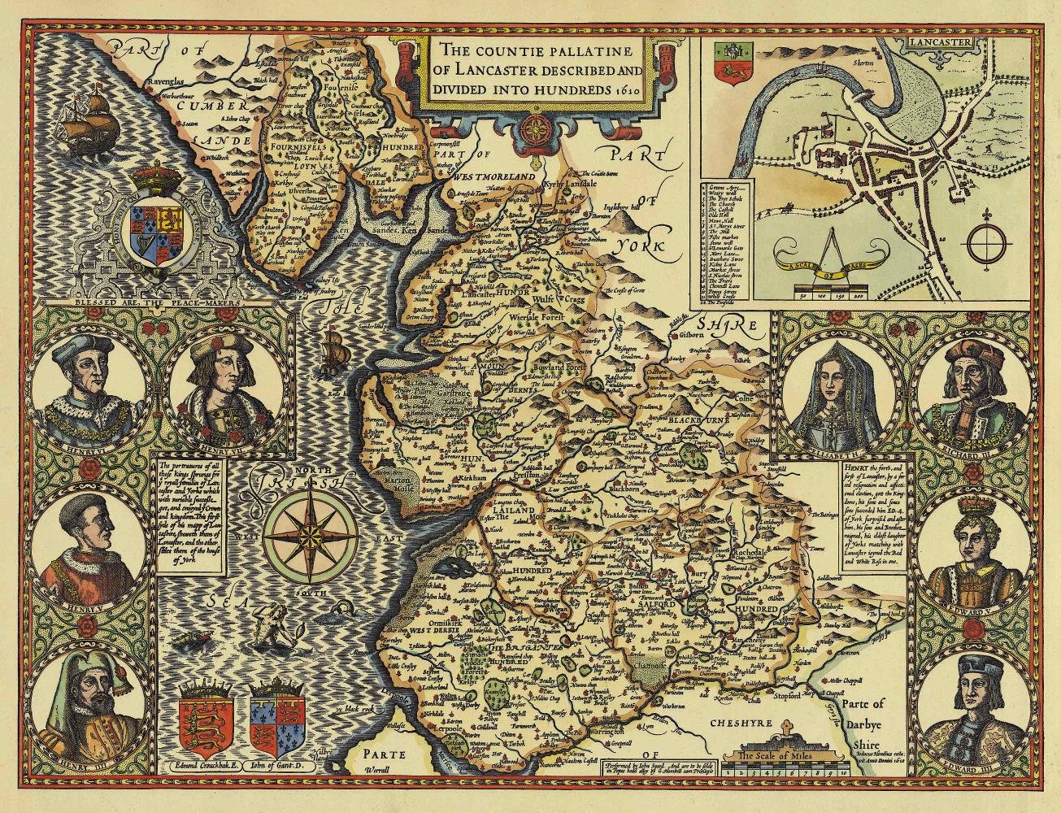
Speed Map Lancashire 1610
Permission granted www3.Lancashire.gov.uk

Slide 4
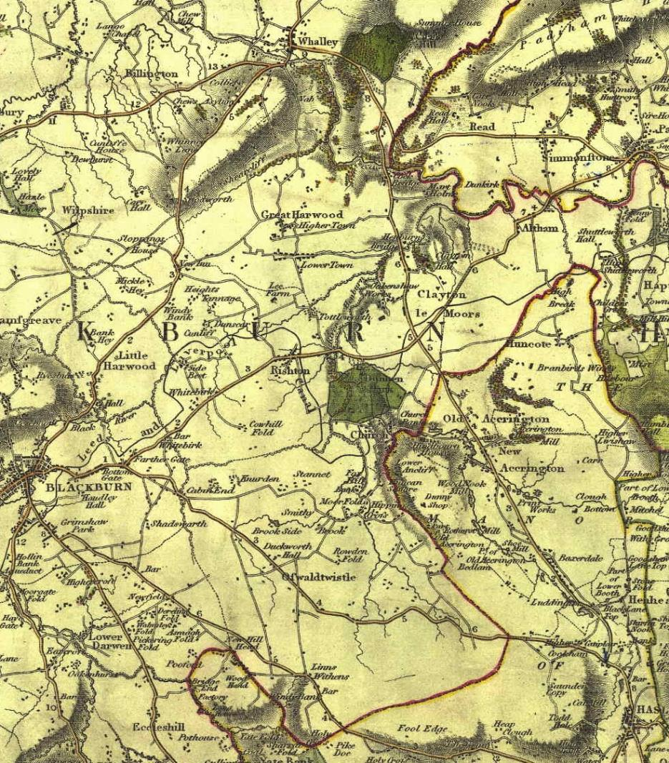
C. Smith map Old and New Accrington 1806
CC –"This work incorporates historical material provided by the Great Britain Historical GIS Project and the University of Portsmouth through their web site A Vision of Britain through Time (http://www.VisionofBritain.org.uk)."

Slide 5
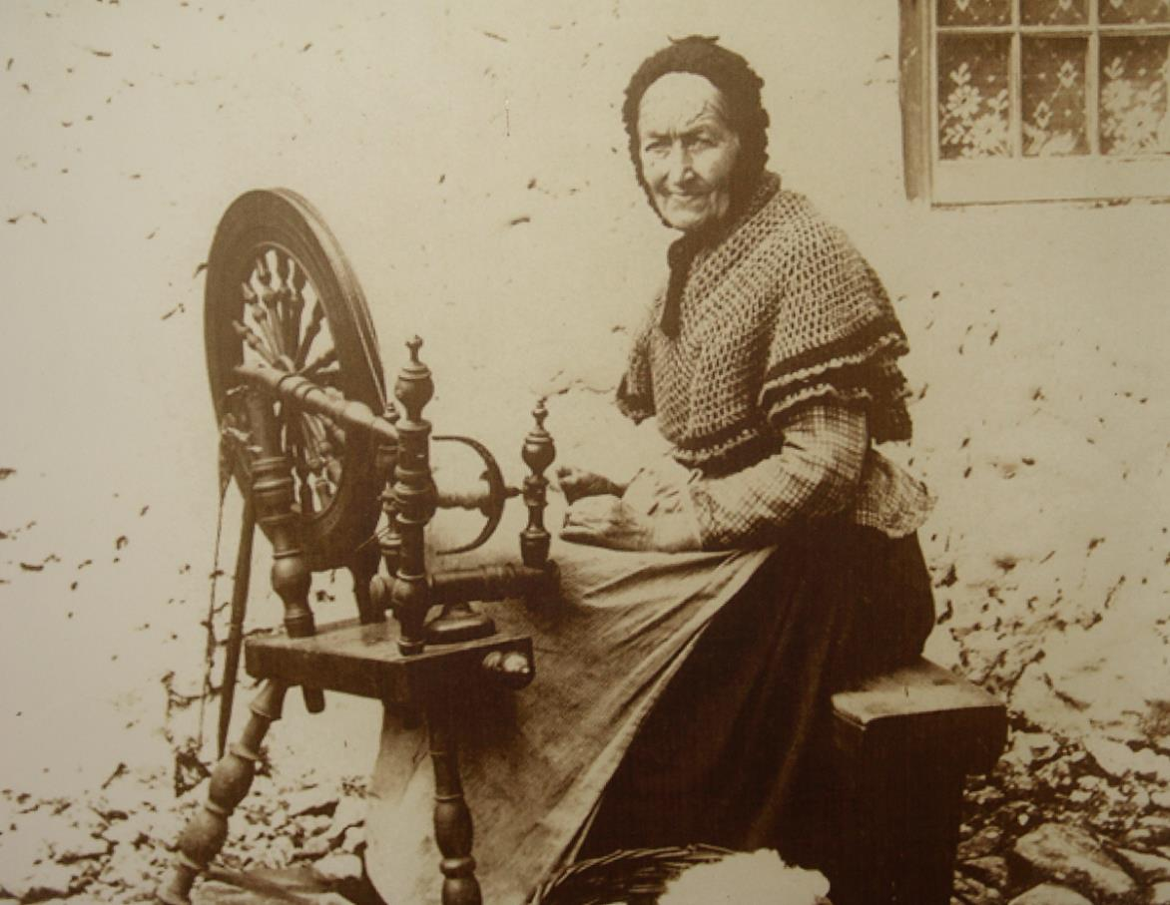
Cottage Weaver, outdoors
Creative Commons Licence

Slide 6
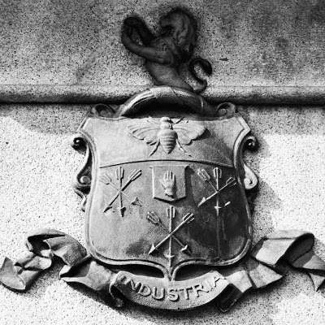
Peel Family Crest
www.busymanbicycle.blogspot.com

Slide 7
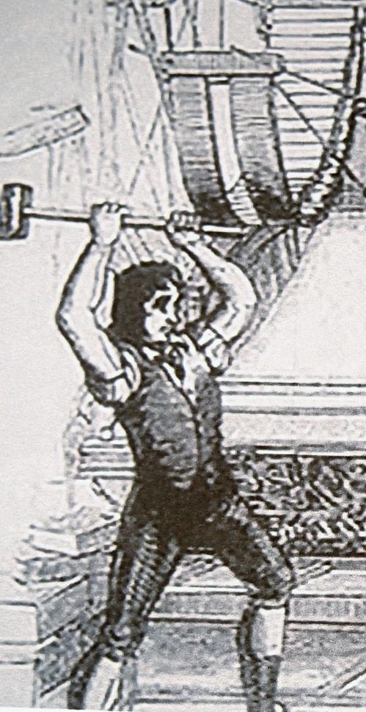
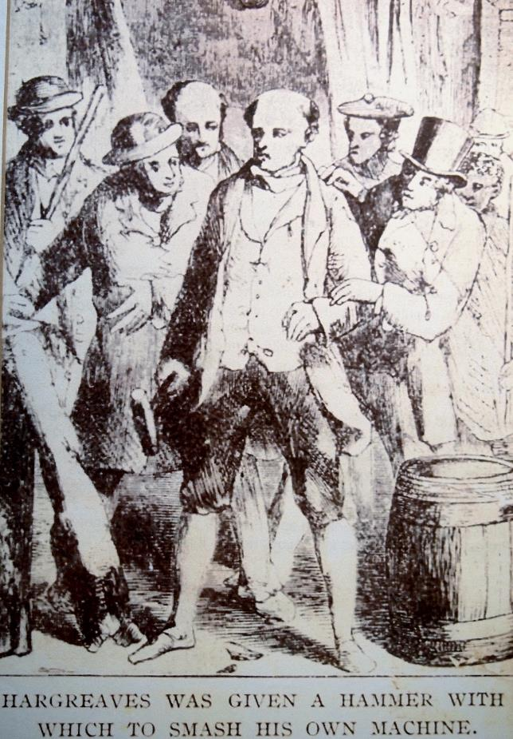
Destruction of looms and spinning jennies
Creative Commons Licence

Slide 8
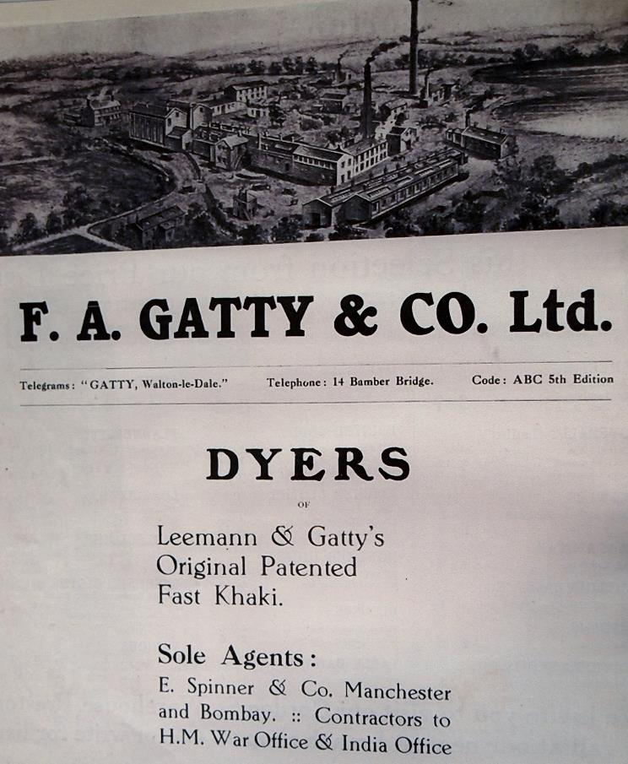
Frederick Gatty – invented method of fixing Turkey Red dye and invented Khaki dye
Preston Digital Archives

Slide 9
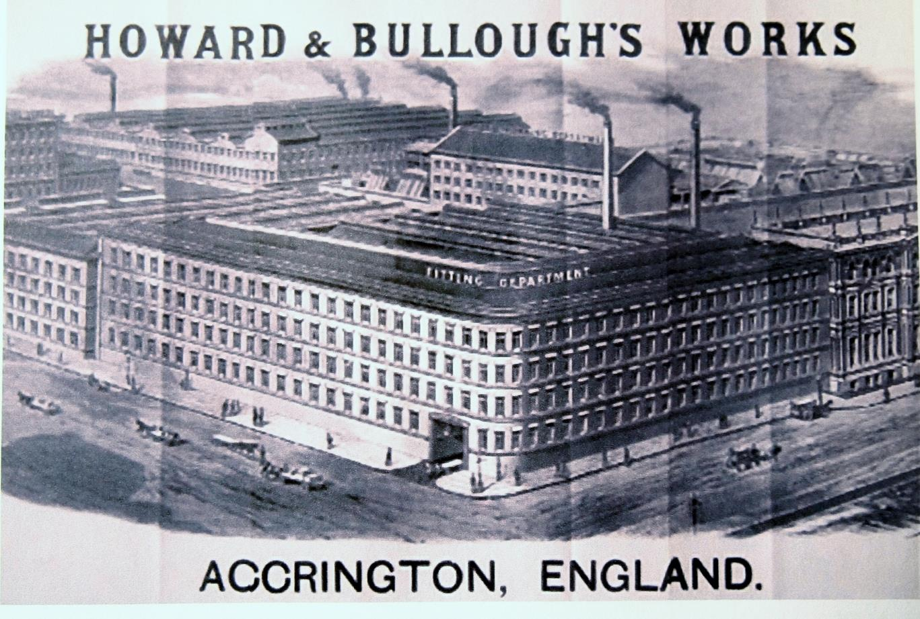
Howard & Bullough’s Globe Works
Accrington Local Studies Library

Slide 10
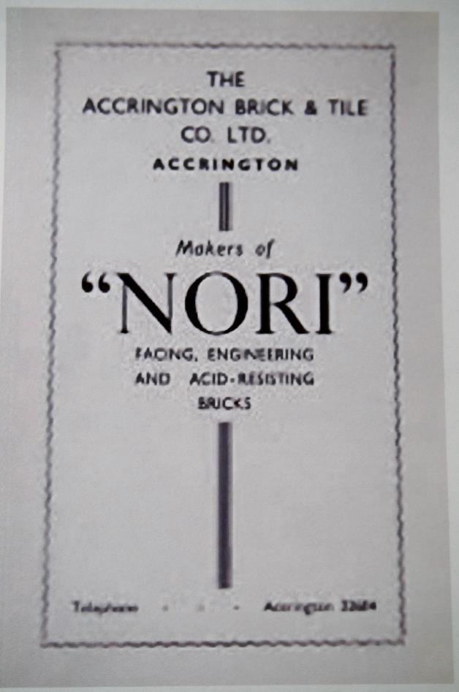
Nori Bricks– Accrington Industry
Accrington Local Studies Library

Slide 11
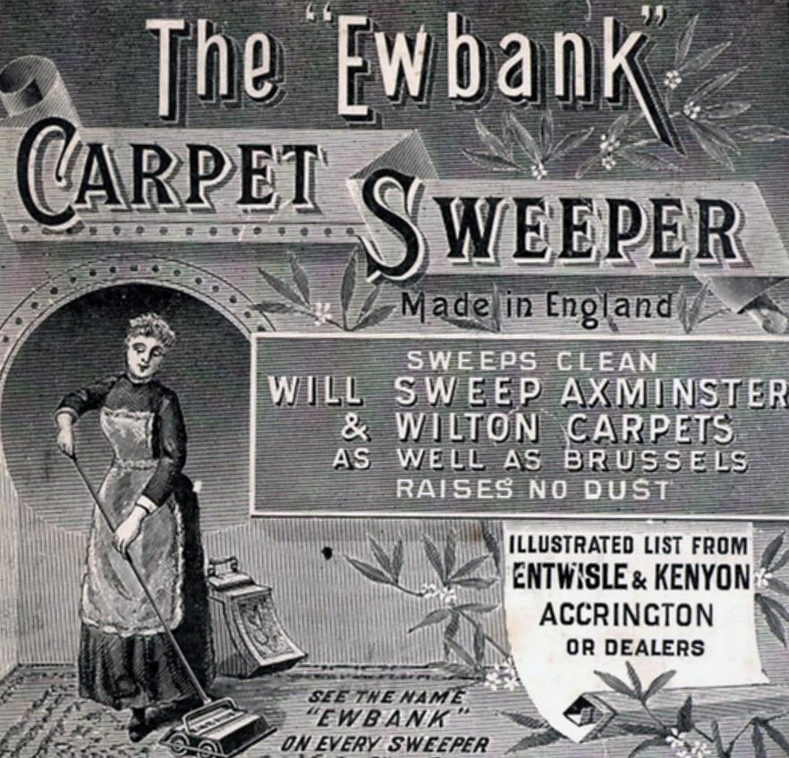
Ewbanks – Accrington Industry
Advertising Archives

Slide 12
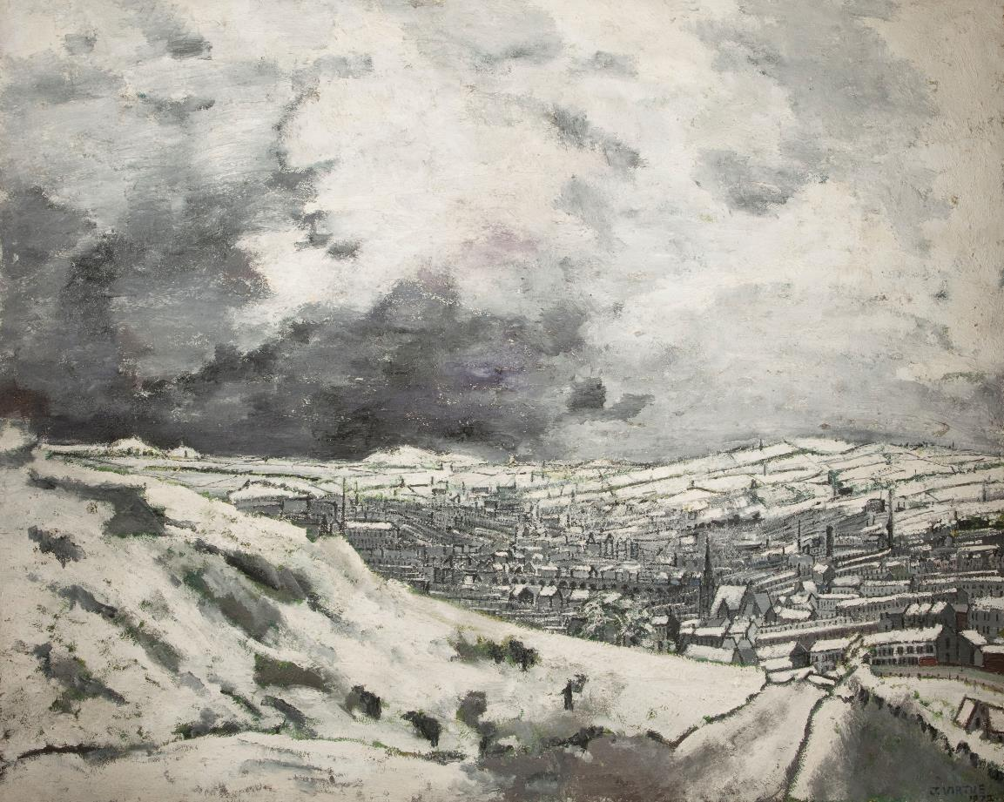
View from the Coppice by John Virtue
Copyright Haworth Art Gallery

Slide 13
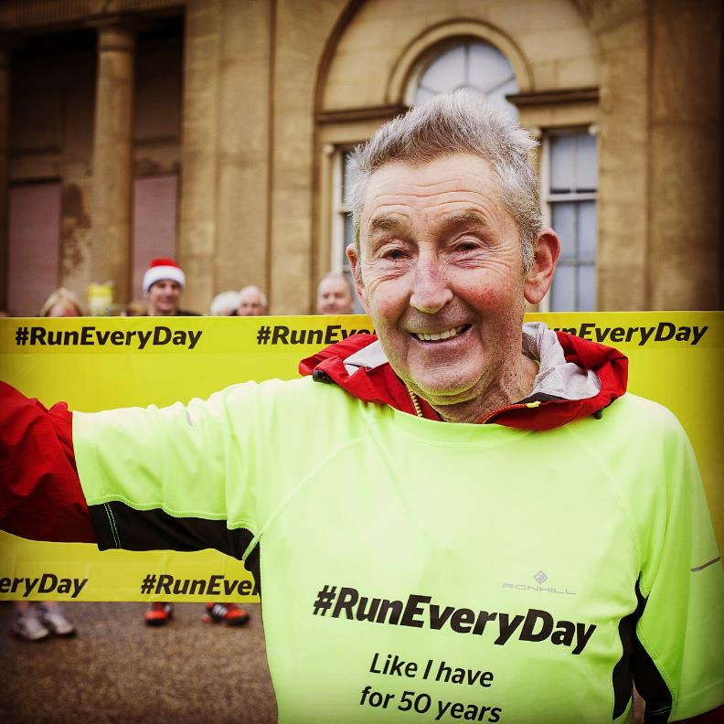
Ron Hill – Accrington athlete and textile entrepreneur
Copyright Ron Hill

Slide 14
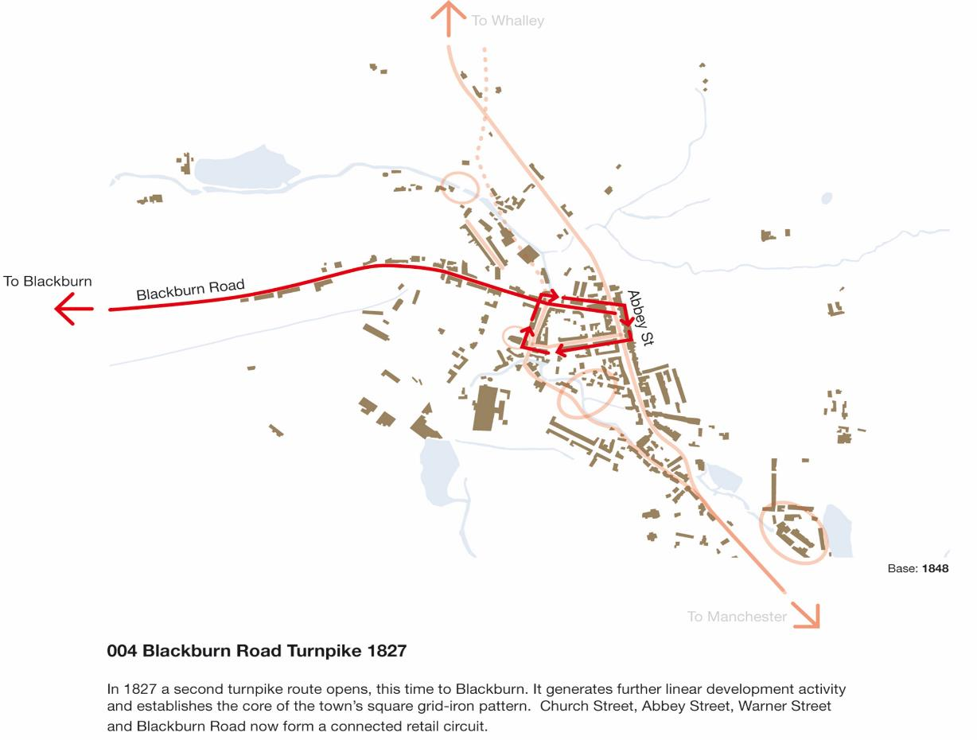
Turnpike Road 1827
Creative Commons – by kind permission of Urbed

Slide 15
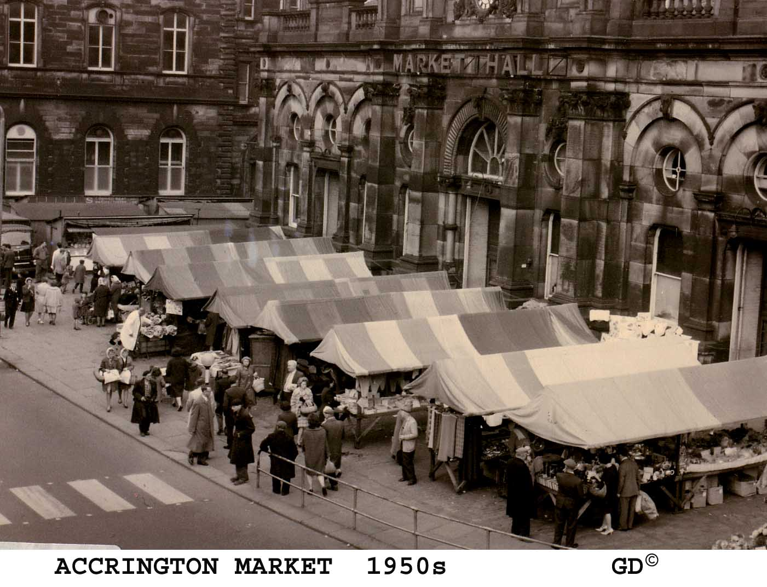
Accrington Market 1950s
Copyright Garth Dawson

Slide 16
Burtons under construction, Woolworths, opposite Town Hall
Copyright Accrington Local Studies Library

Slide 17
Blackburn Road towards Town Hall 1940s
Copyright Garth Dawson

Slide 18
Blackburn Road opposite Town Hall 1962
Copyright Accrington Local Studies Library

Slide 19
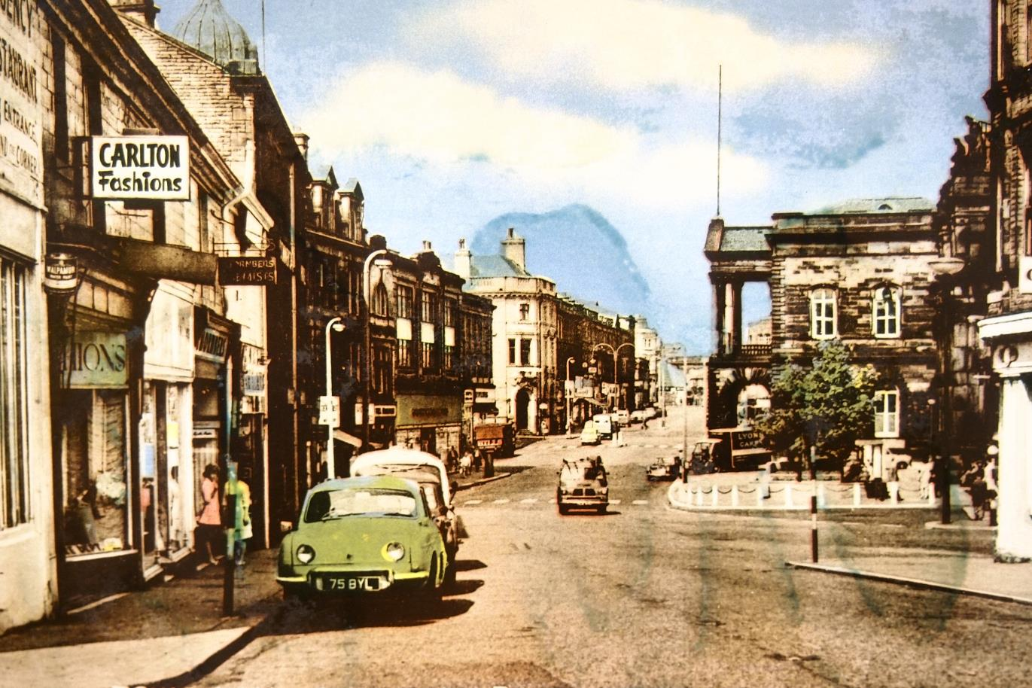
Towards Town Hall, 1960s
Copyright Accrington Local Studies Library

Slide 20
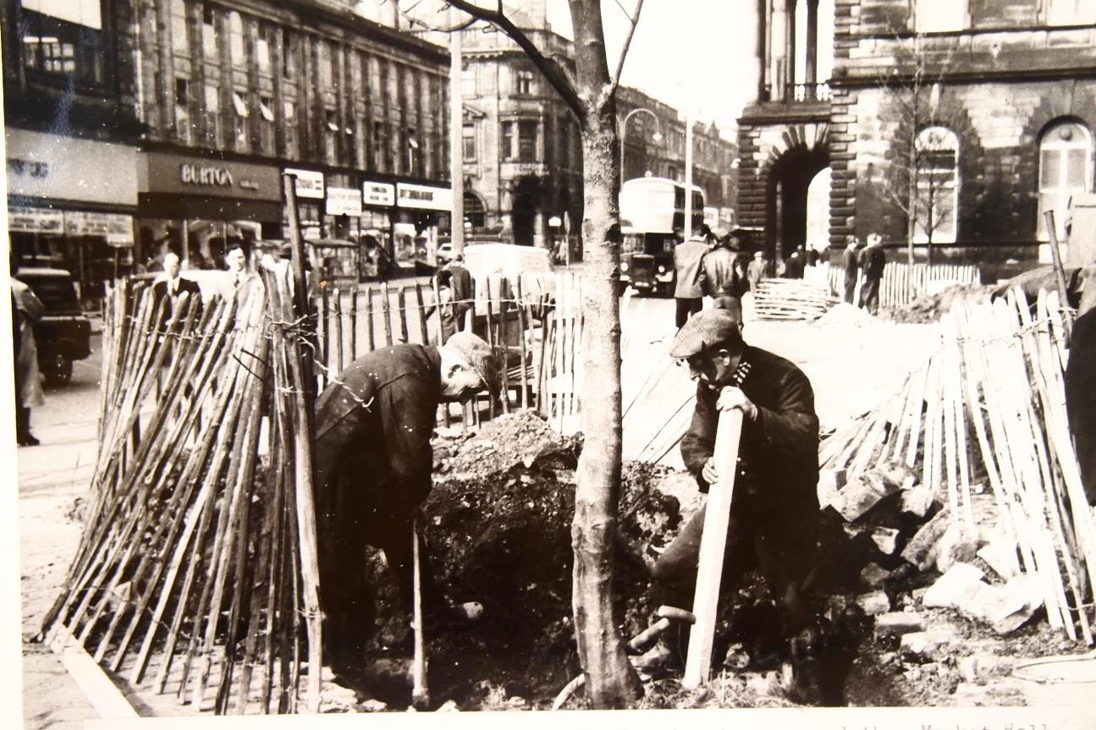
Spanish chestnut trees being planted outside Town Hall 1960s
Accrington Local Studies Library

Slide 21
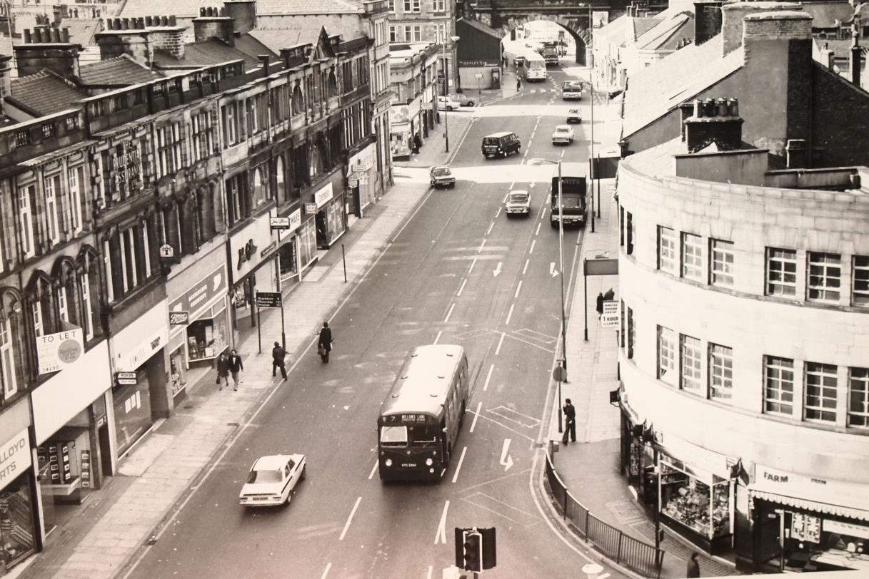
Blackburn Road from roof of Town Hall
Accrington Local Studies Library

Slide 22
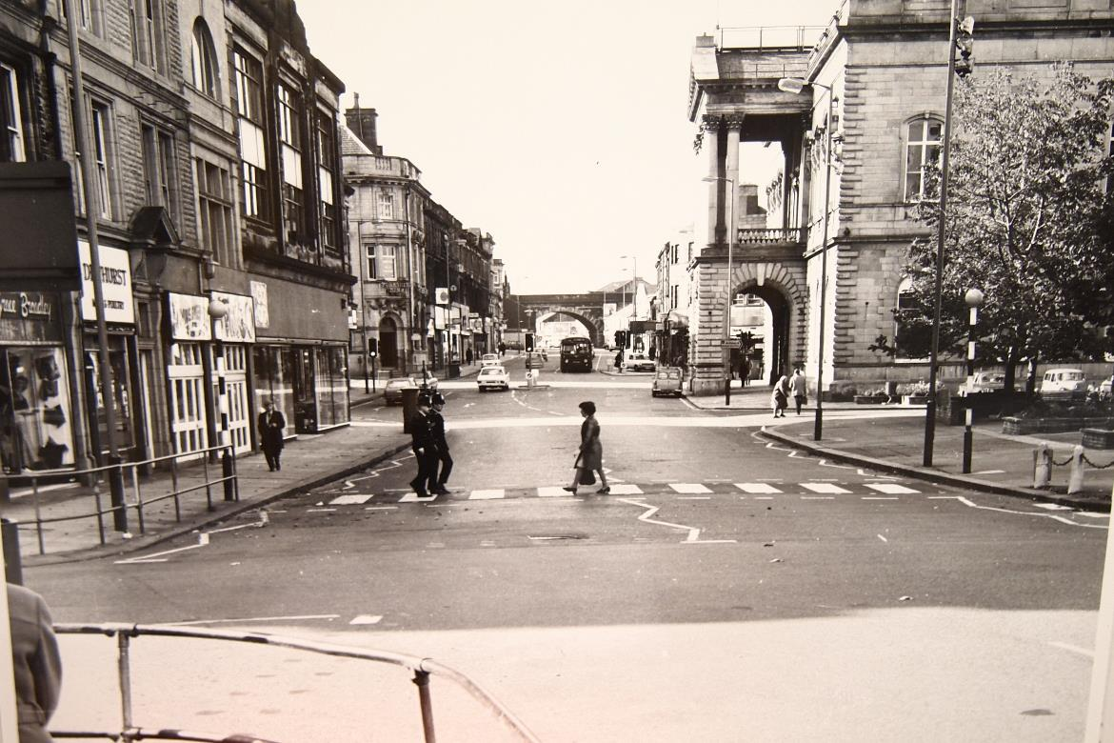
Zebra crossing at the top of Blackburn Road
Why not recreate this
photograph with
children from your class!
Accrington Local Studies Library

Slide 23
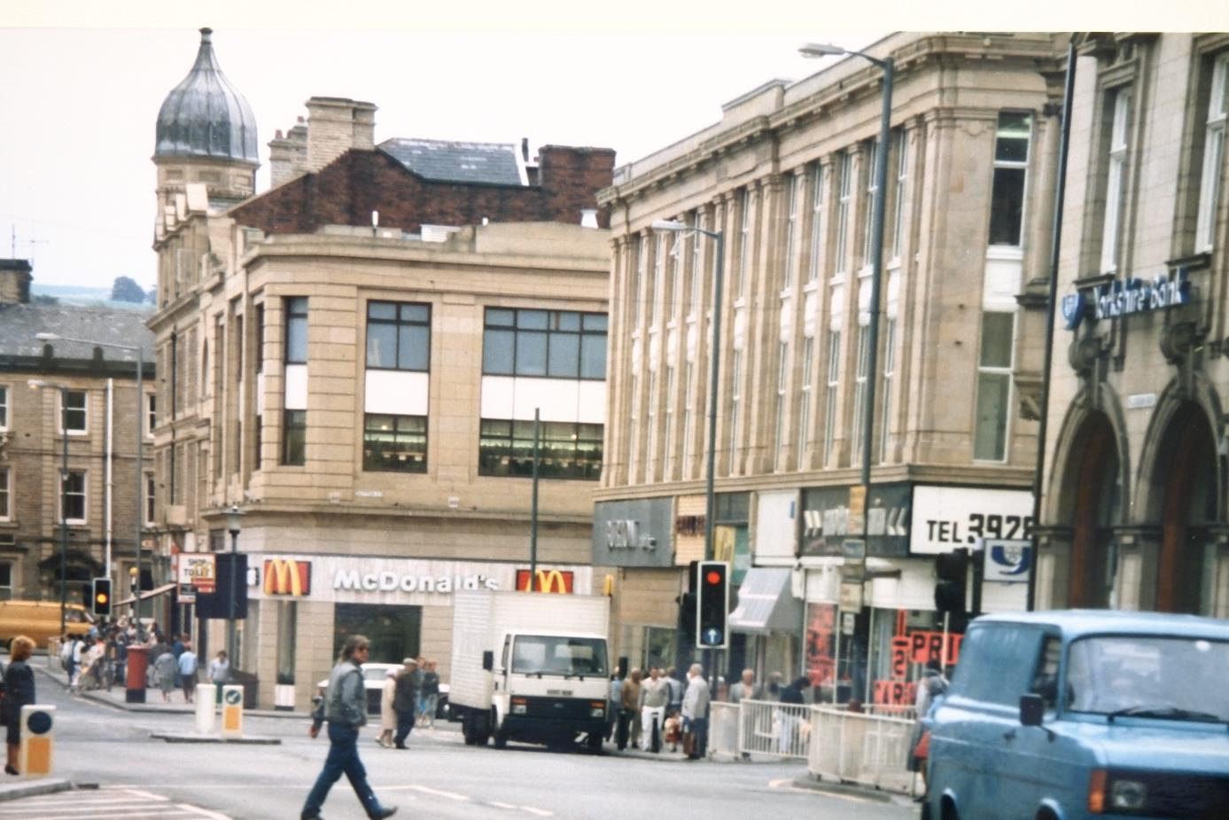
MacDonalds 1987, former sites of Woolworths and Burtons can be seen
Accrington Local Studies Library

Slide 24
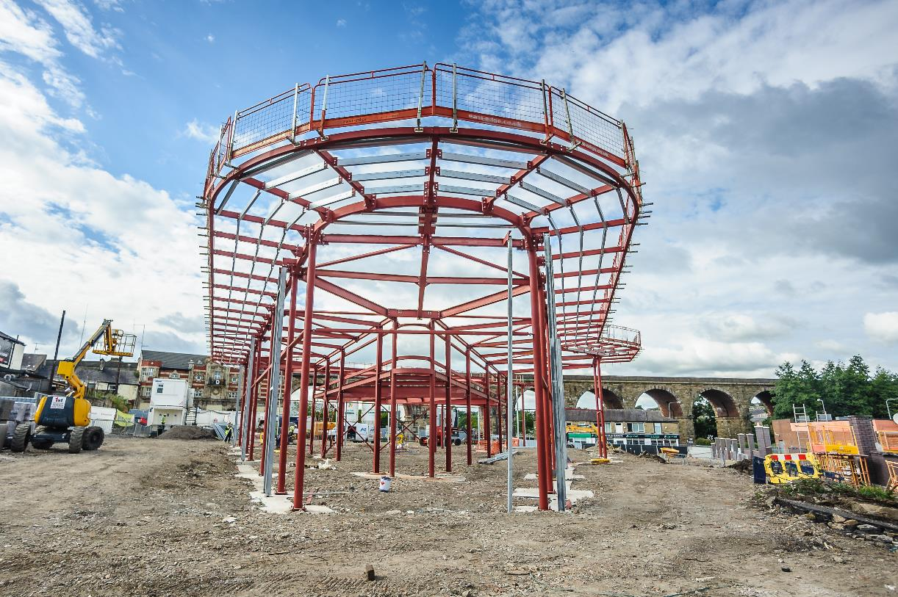
George Slynn bus station under construction
Copyright Wayne Rushworth

