Slide 1
King George III topographical views of Leeds
A series of hand painted views of Leeds from the 18th and 19th centuries.

Slide 2
King George III’s map collection
The King’s Topographical Collection, the map collection of George III, is one of the world’s most important historical resources.
The collection has approximately 50,000 maps, plans and views. These are printed, painted and hand-drawn maps and landscapes, of all parts of the world, particularly Great Britain and the then British Empire.
The maps ranges in date from about 1540 to 1824.

Slide 3
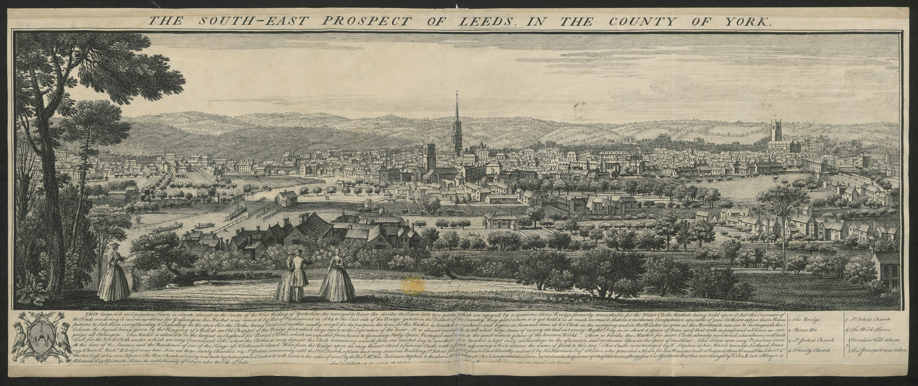
A view of Leeds in 1743

Slide 4
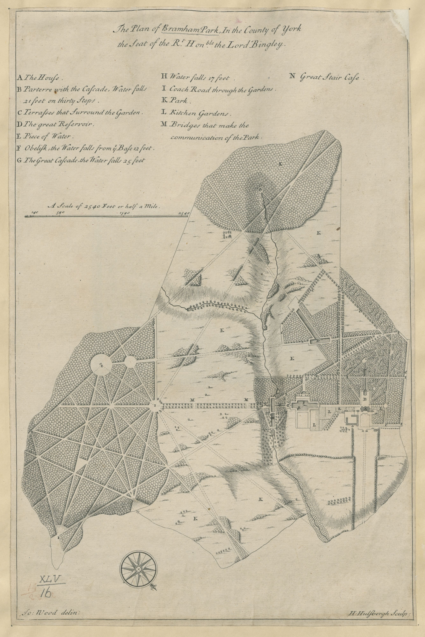
Bramham Park
1713

Slide 5
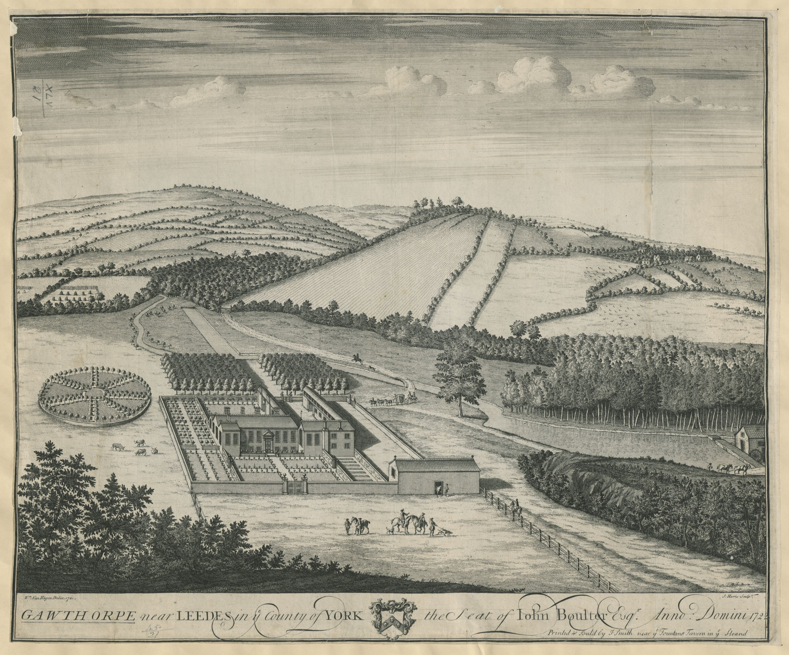
Gawthorpe
1722

Slide 6
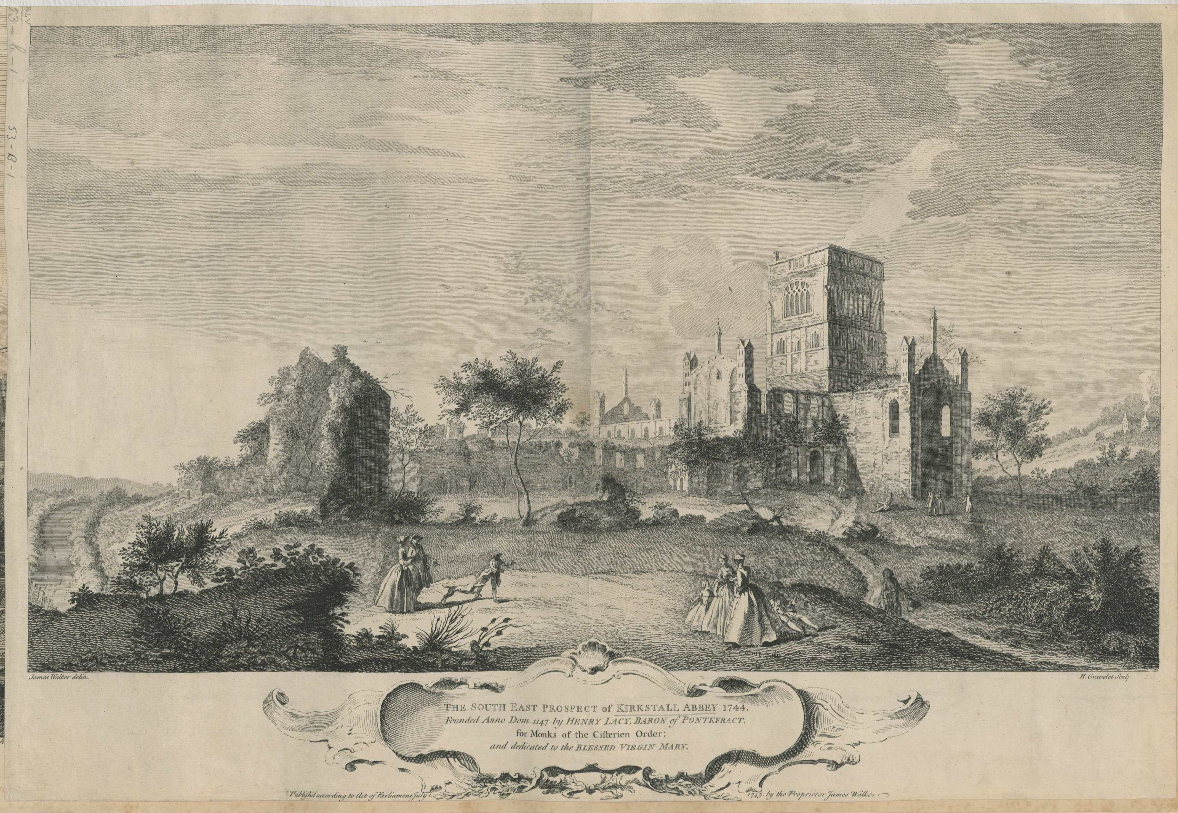
Kirkstall Abbey
1744

Slide 7
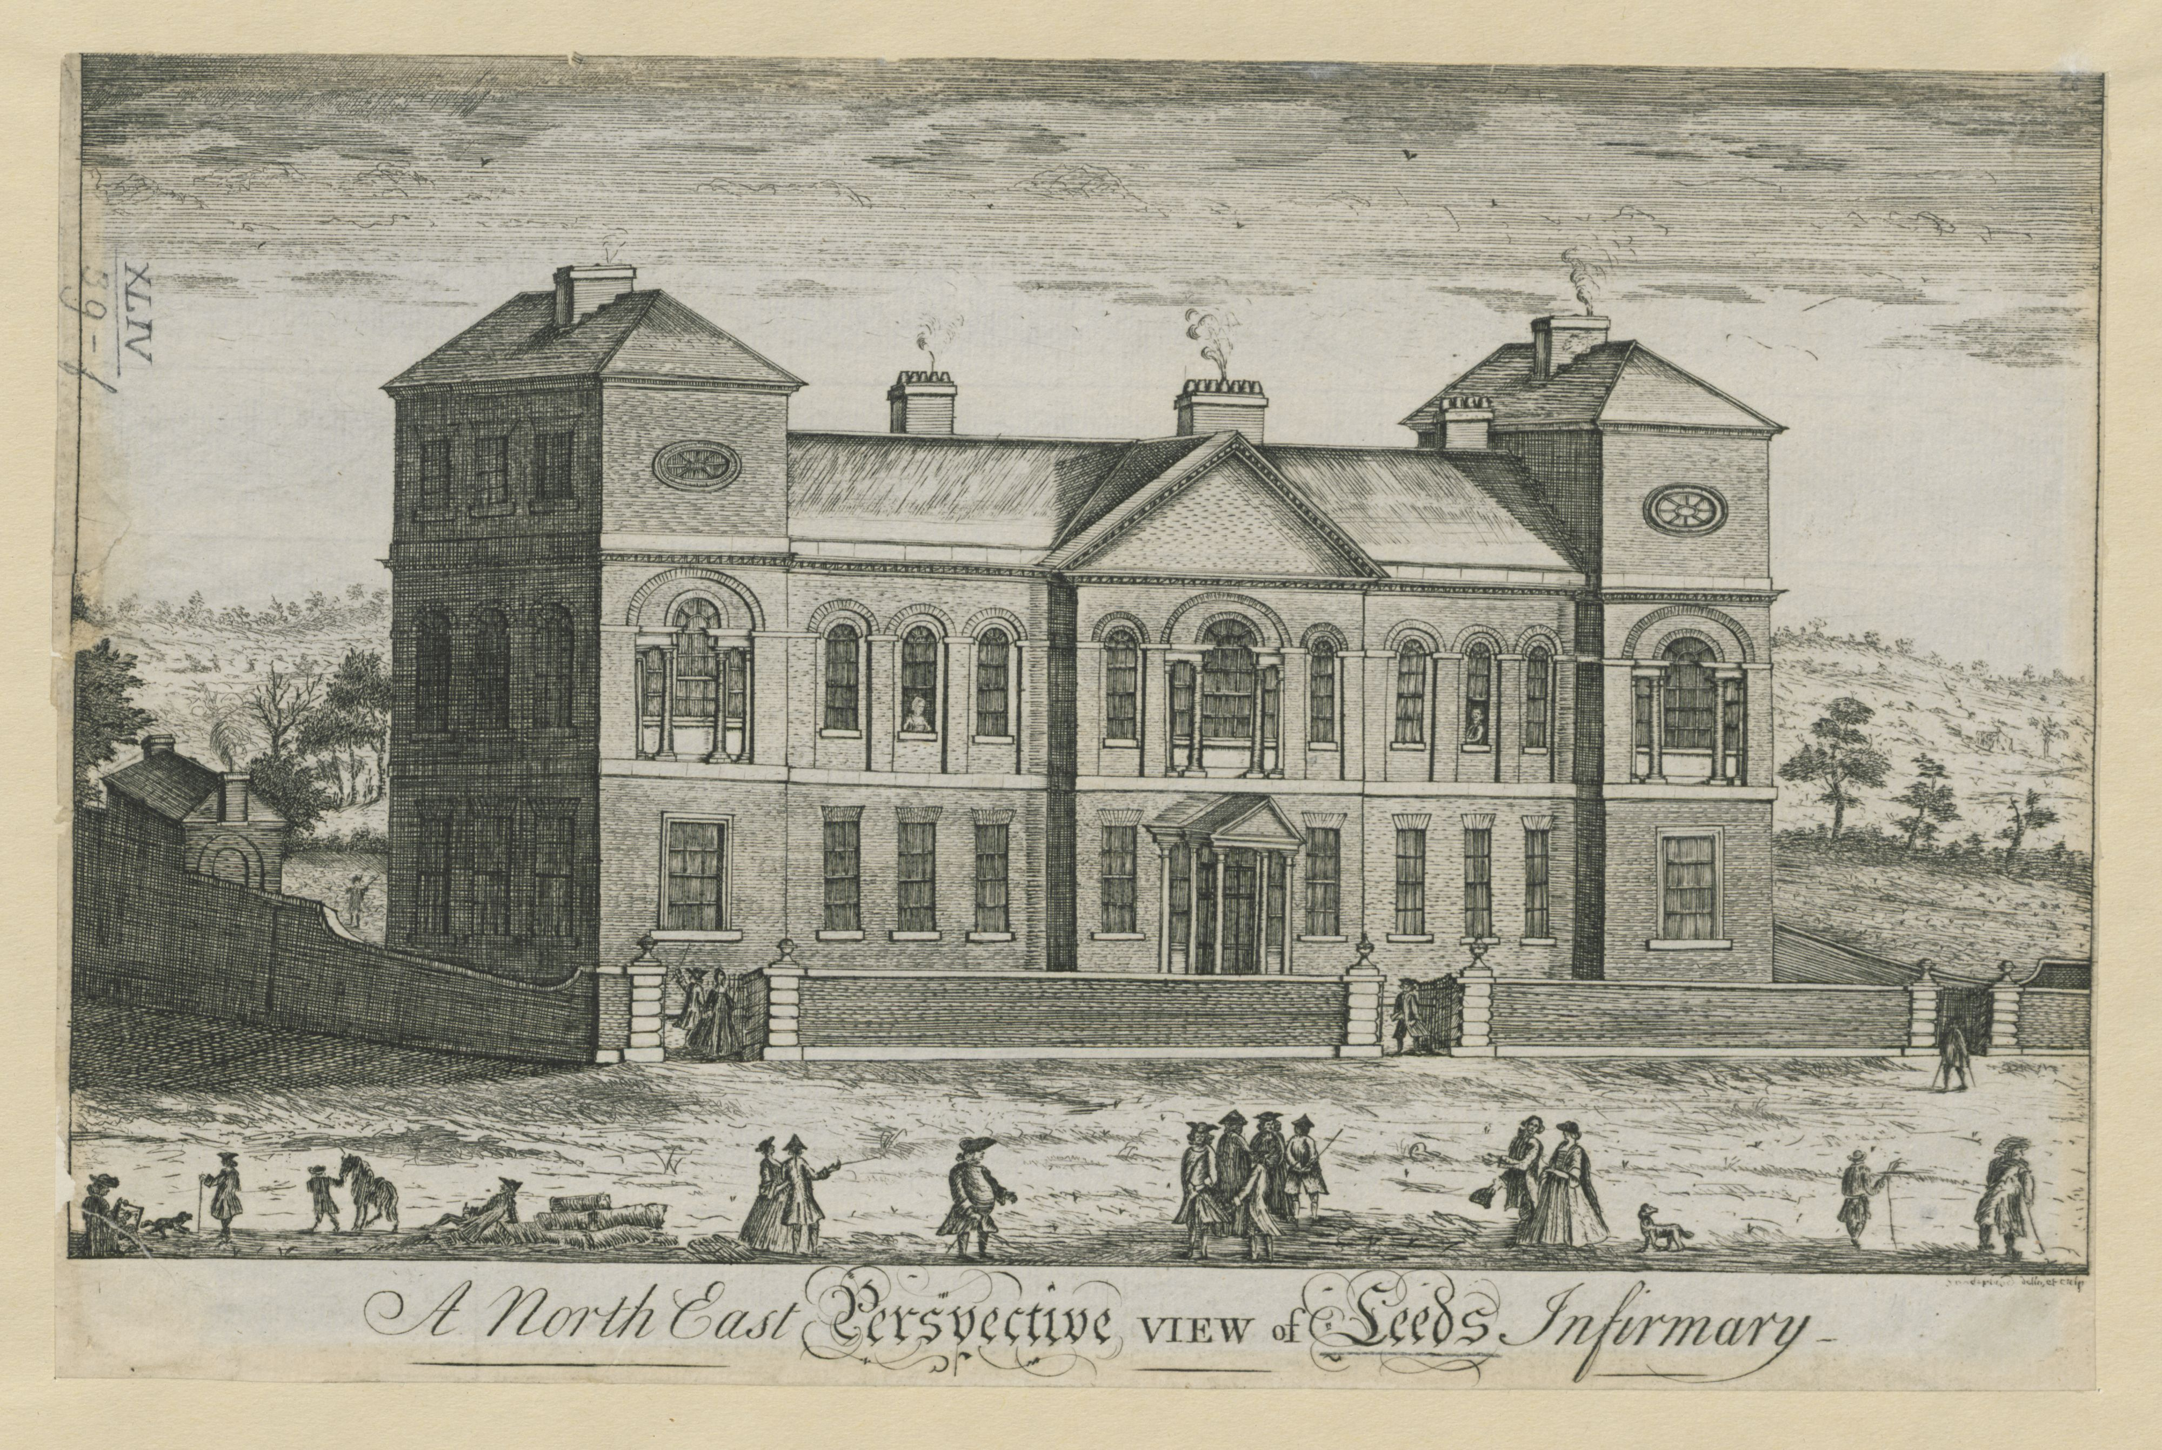
Leeds Infirmary
1771

Slide 8
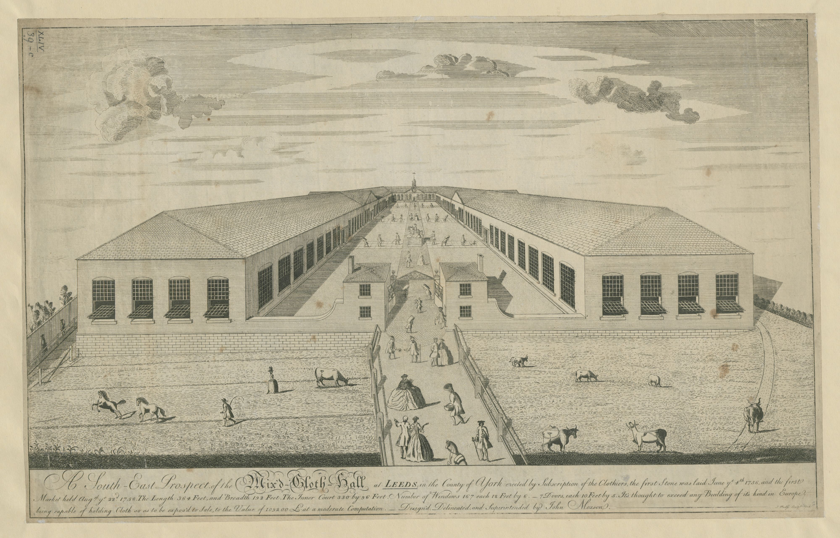
The Mixed Cloth Hall
1758

Slide 9
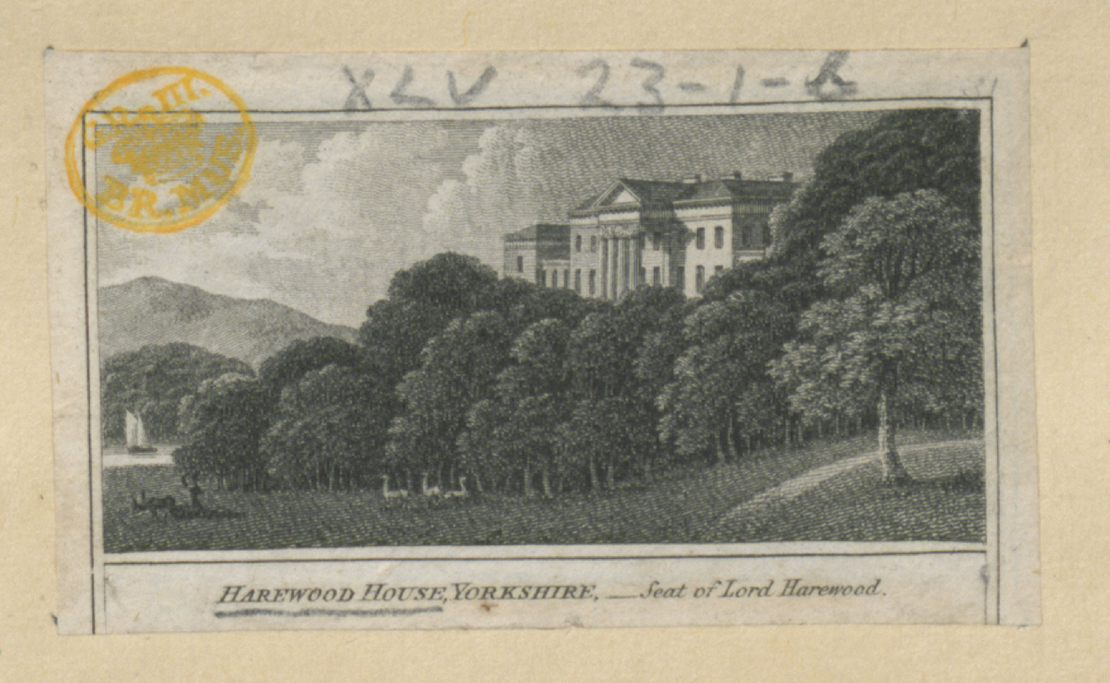
Harewood House
1810

