Slide 1
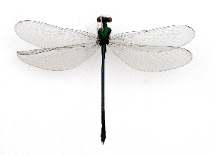
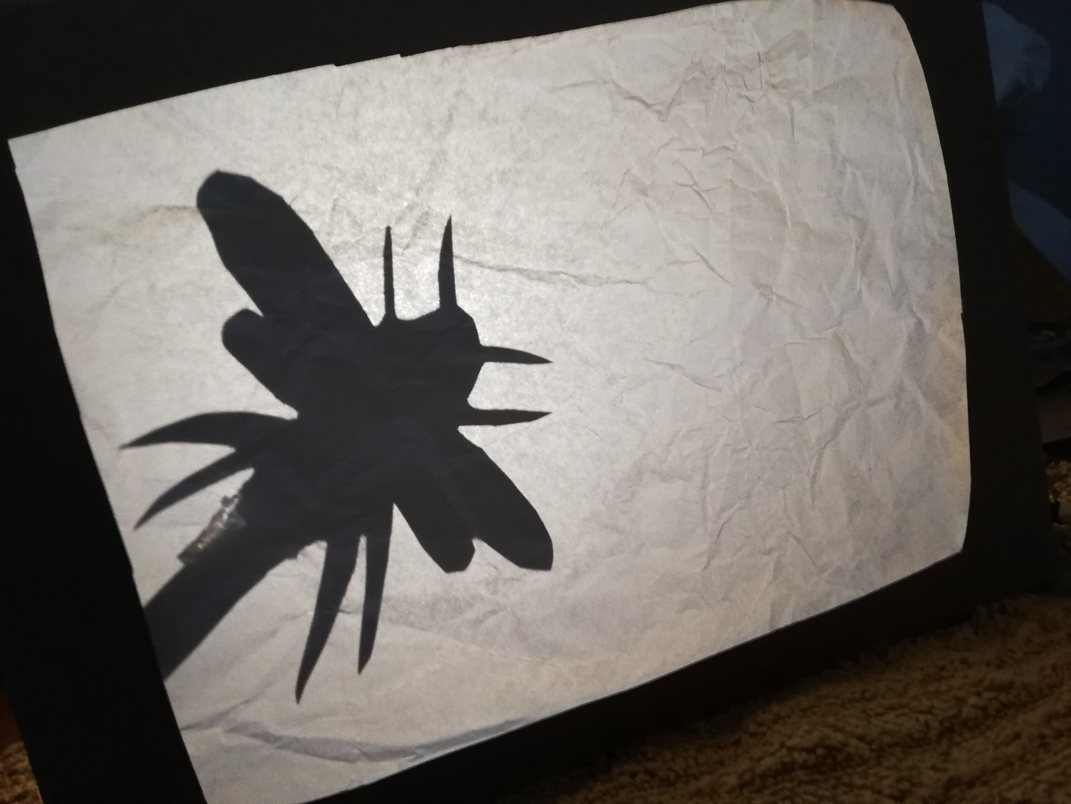
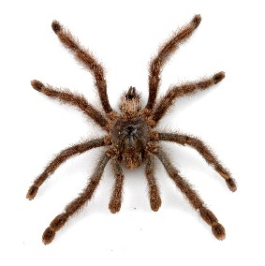
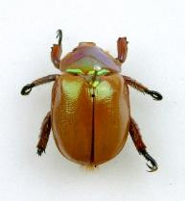
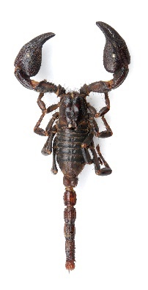
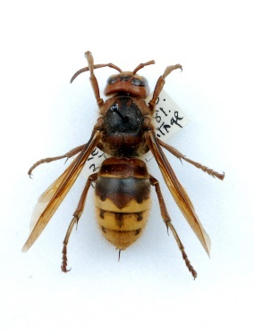
Make a Bug Shadow Theatre

Slide 2
You will need:
A cereal box
White tissue paper, or thin paper
Scissors
Tape or glue
A torch, or the torch on a phone
You as the puppeteer!

Slide 3
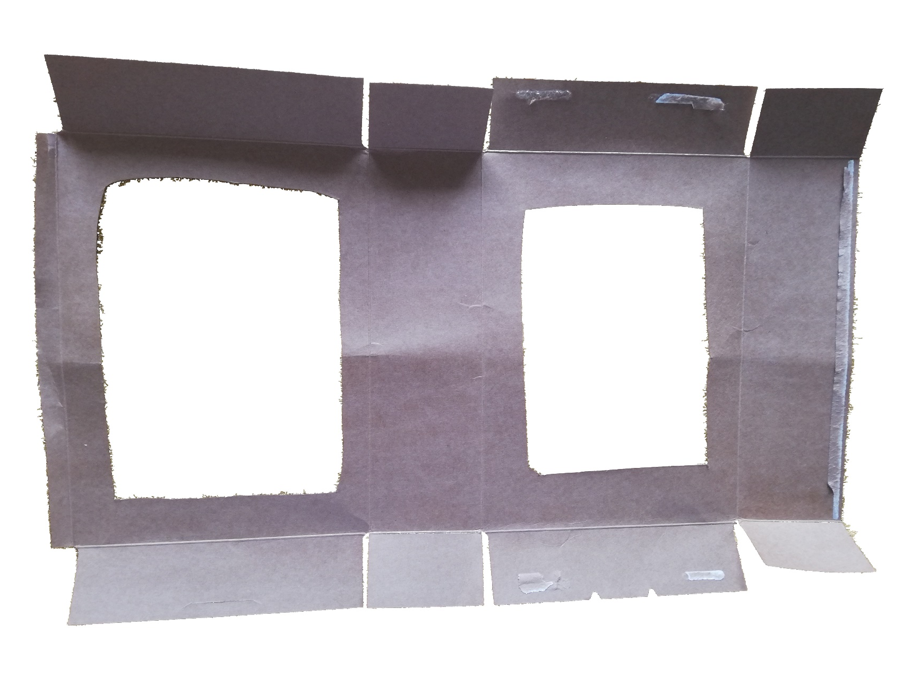
Step 1
Open up a cereal box, and cut a hole in the front and back

Slide 4
Step 2
Save the cut out pieces for later!

Slide 5
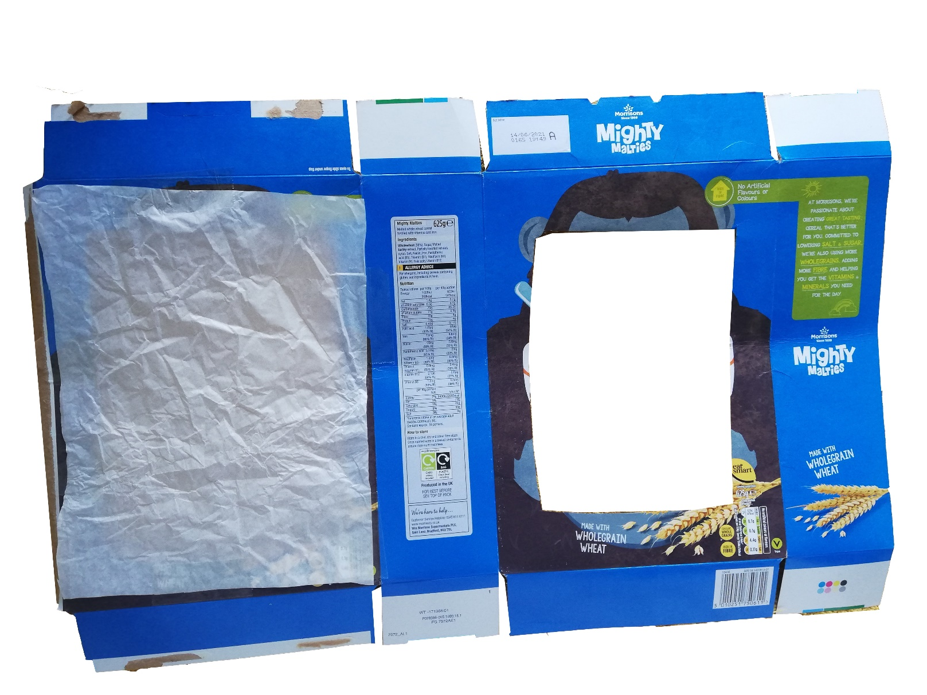
Step 3
Turn it over and stick white tissue paper over one of the holes

Slide 6
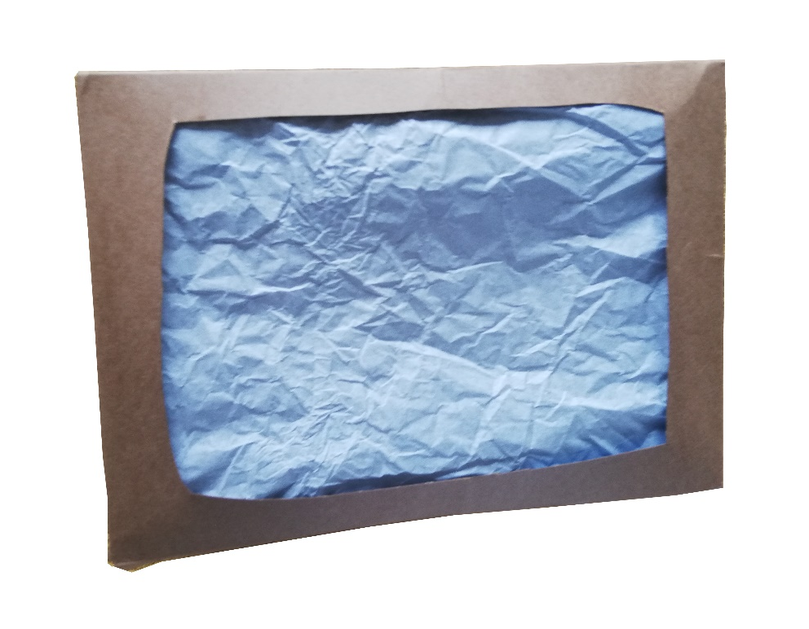
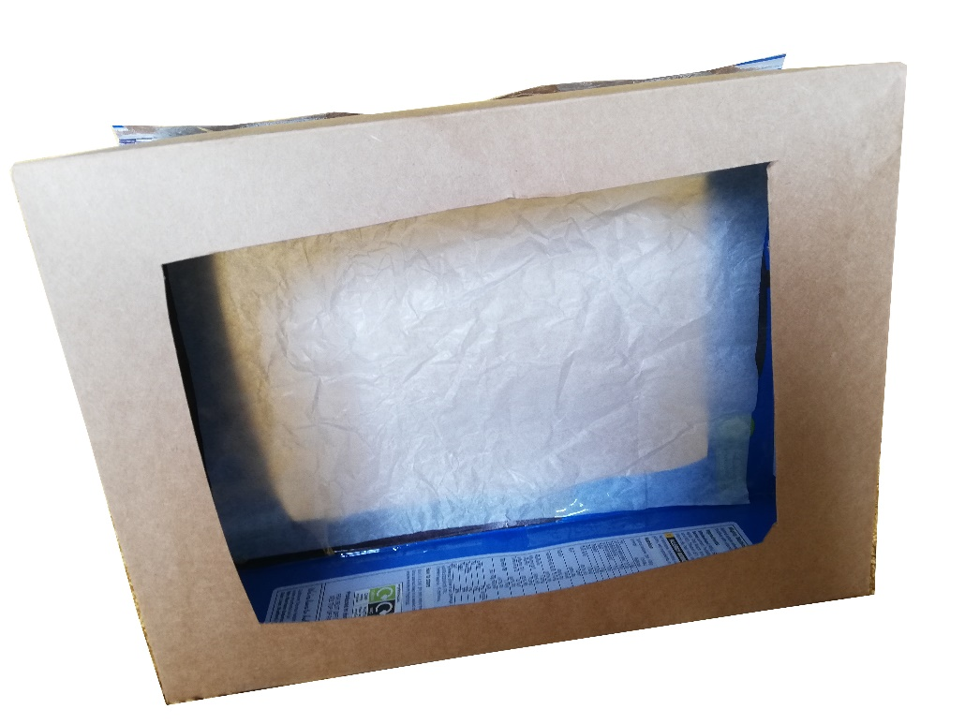
Step 4
Put the box back together!
Front view
Rear view

Slide 7
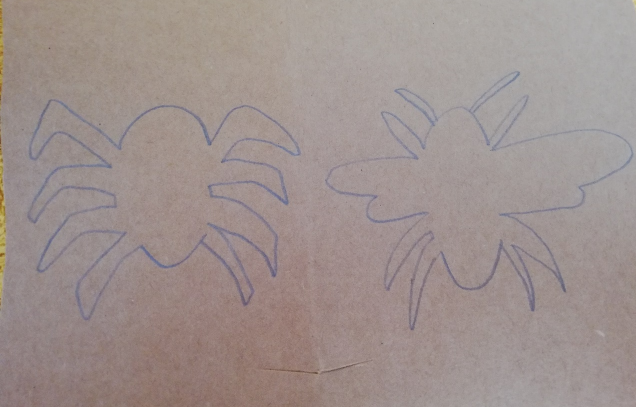
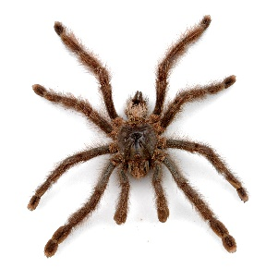
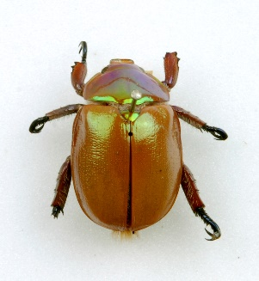
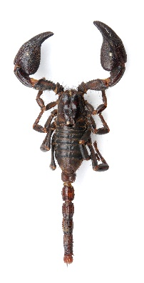
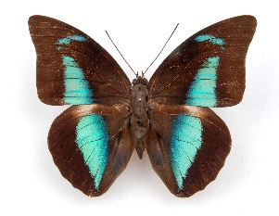
Step 5
Cut out animal shapes and stick them on lollipop sticks (or use cardboard if you don’t have lollipop sticks).
Tip: Make simple shadow puppets, and not too big!

Slide 8
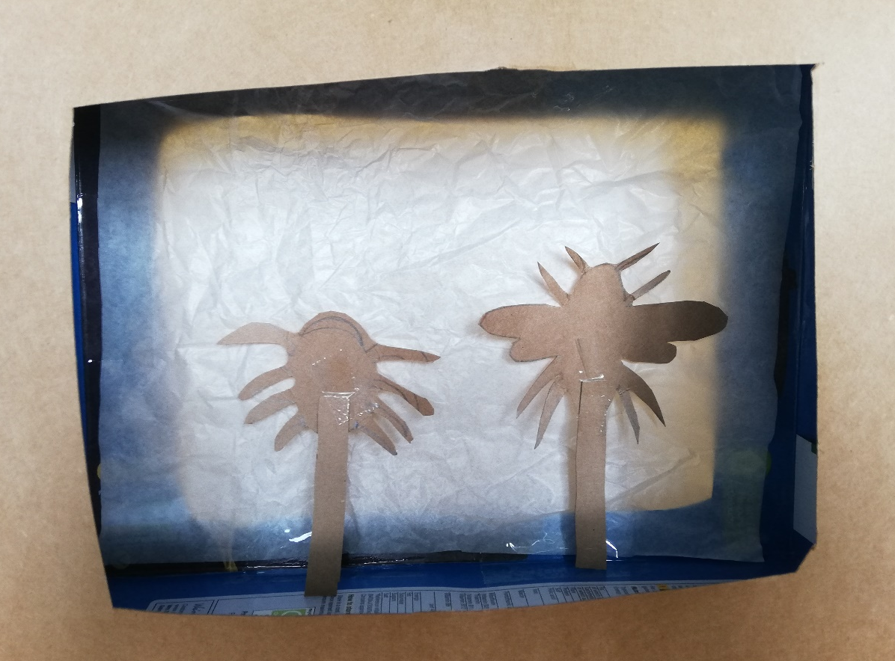
Step 6
Get a torch ready…
(or a phone torch)

Slide 9
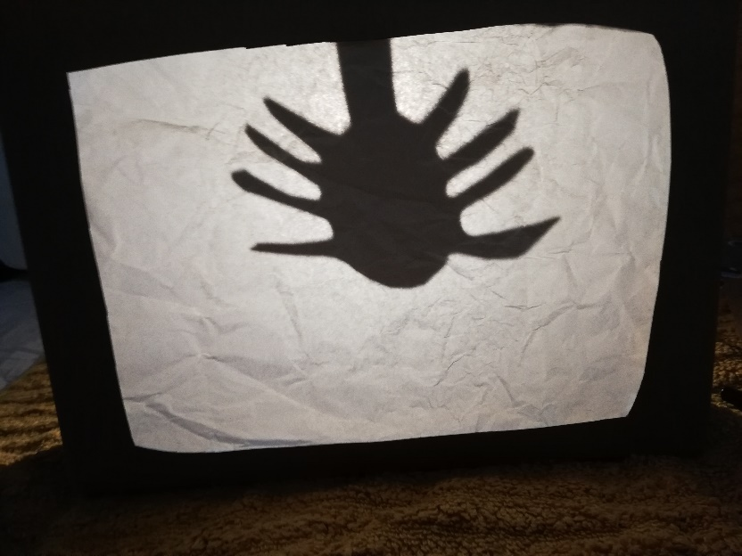
Step 7
Show time!
See what happens when you move the puppet closer to the torch!
What stories will you tell using your puppet theatre?

