Slide 1
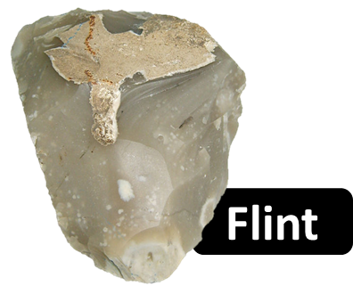
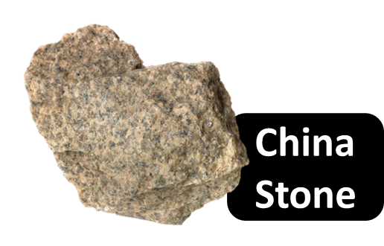
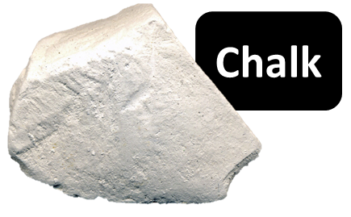
These three types of rock were all crushed at Thwaite Watermill.
Draw lines or colour code to match the rock types to their descriptions and uses.
ROCKS
DESCRIPTIONS
USES
A very soft, white, sedimentary rock which is very porous (full of tiny holes).
A hard, tough, sedimentary rock. On the inside, or when broken into smaller pieces, it is very smooth and appears waxy or glassy.
A type of granite (an igneous rock) which contains sparkling specks of mica and quartz. It can show many colours, including purple, red, brown, white and pink.
Making tools such as hand axes in prehistoric times. Starting fires in prehistoric times, by hitting pieces together to create a spark. Building, historically and today. Pieces are ‘knapped’ so the smooth, glassy inside is visible. Making glaze, the shiny surface on some pottery (such as mugs and plates).
Making products such as paint, toothpaste and putty (for sealing window frames). Writing on blackboards and pavements. Absorbing sweat from gymnasts’ hands, giving them better grip. Making soil less acidic to help certain plants grow better.
Making glaze, the shiny surface on some pottery (such as mugs and plates). Building, to add more colour.

Slide 2
Answers
*These were the products made using rock crushed at Thwaite Watermill.
ROCKS
DESCRIPTIONS
USES
A very soft, white, sedimentary rock which is very porous (full of tiny holes).
A hard, tough, sedimentary rock. On the inside, or when broken into smaller pieces, it is very smooth and appears waxy or glassy.
A type of granite (an igneous rock) which contains sparkling specks of mica and quartz. It can show many colours, including purple, red, brown, white and pink.
Making tools such as hand axes in prehistoric times. Starting fires in prehistoric times, by hitting pieces together to create a spark. Building, historically and today. Pieces are ‘knapped’ so the smooth, glassy inside is visible. Making glaze, the shiny surface on some pottery (such as mugs and plates).
Making products such as paint, toothpaste and putty (for sealing window frames). Writing on blackboards and pavements. Absorbing sweat from gymnasts’ hands, giving them better grip. Making soil less acidic to help certain plants grow better.
Making glaze, the shiny surface on some pottery (such as mugs and plates). Building, to add more colour.

Slide 3
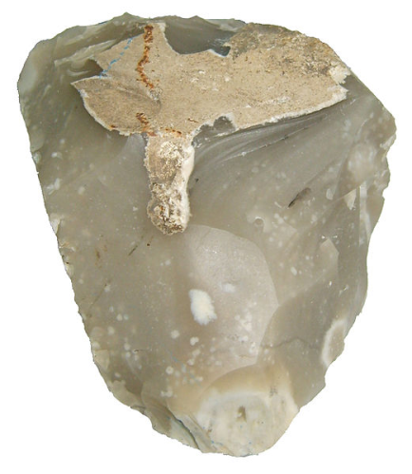
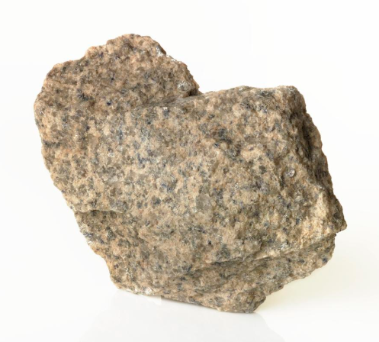
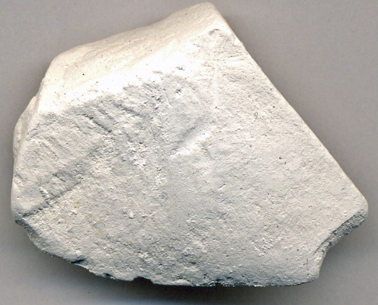
Image References
Flint image – released under a ‘Creative Commons Attribution-Share Alike 3.0 Unported’ license, taken by Otis Crandell and displayed on Wikipedia.
Link to license: https://creativecommons.org/licenses/by-sa/3.0/legalcode
China stone image – released under a ‘Creative Commons Attribution-NonCommercial-ShareAlike 4.0’ license and displayed on the Science Museum Group website.
Link to license: https://creativecommons.org/licenses/by-nc-sa/4.0/legalcode
Chalk image – released under a ‘Creative Commons Attribution 2.0 Generic’ license, taken by James St. John and displayed on Flickr.
Link to license: ttps://creativecommons.org/licenses/by/2.0/legalcode

