Slide 1
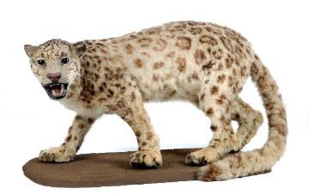
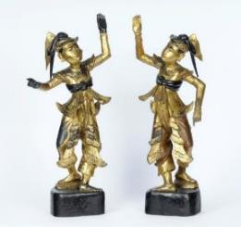
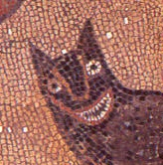
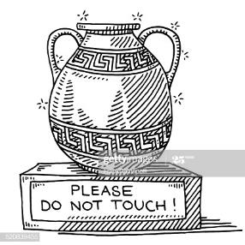
Activities for a Socially Distanced Classroom
by Leeds City Museum

Slide 2
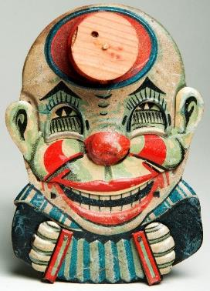
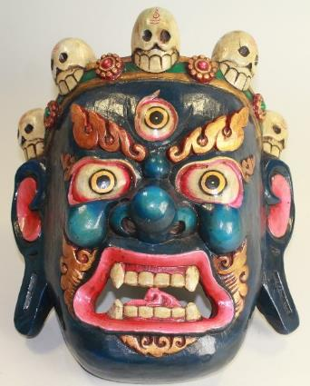
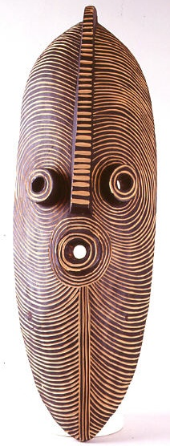
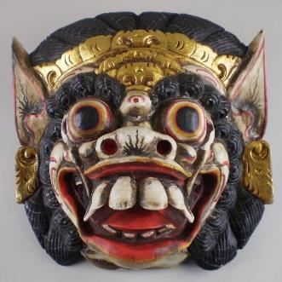
Pull a face like…
Mechanical clown toy
Buddhist demon mask
Incense burner
African Songye Mask
Demon mask from Bali
Take it in turns. Can you guess which face your friend is copying?
MORE FACES on the next page…

Slide 3
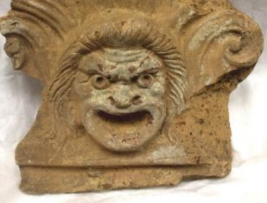
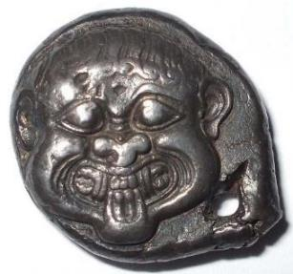
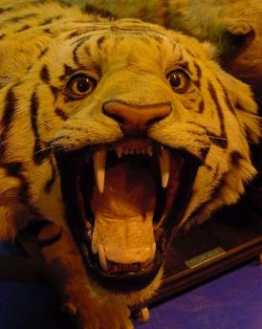
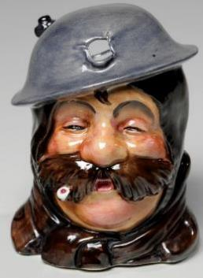
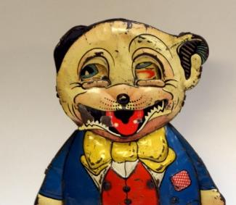
Pull a face like…
Roman roof tile
Gorgon on an Ancient Greek coin
Tiger
WW1 Caricature Jug
Roman mosaic of a wolf
Clockwork toy dog
Take it in turns. Can you guess which face your friend is copying?
Other activity ideas: Write ‘speech bubbles’ for them! What are they saying?

Slide 4
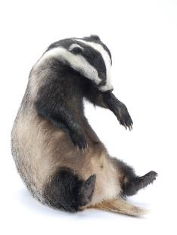
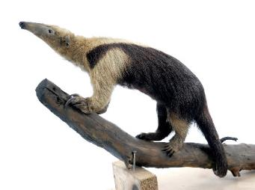
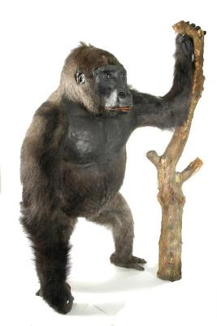
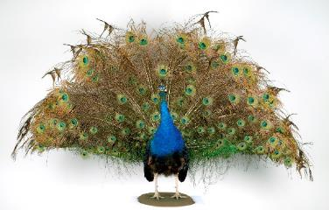
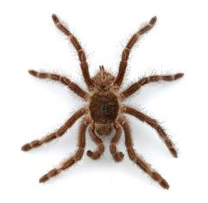
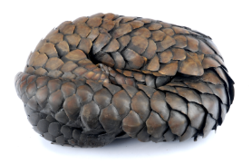
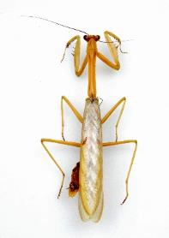
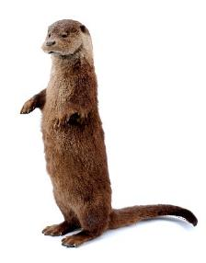
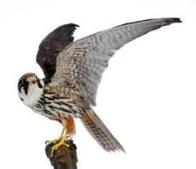
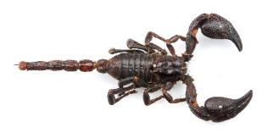
Strike a pose like…
Badger
Tamandua
Gorilla
Peacock
Snow leopard
Mantis
Pangolin
Tarantula
Scorpion
Otter
Peregrine
falcon
Take it in turns to make a pose like one of these animals.
Can you guess which animal they are copying?
Other activity ideas: Sketching; Describing; Write a story about 2 or more of these animals; Sculpt with newspaper

Slide 5
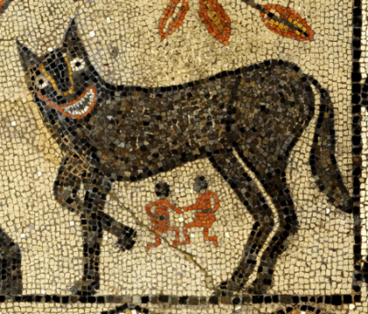
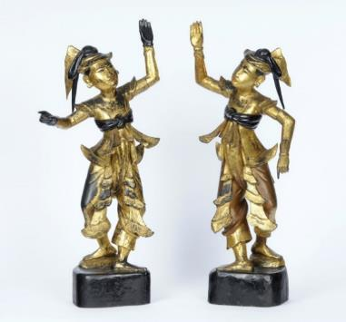
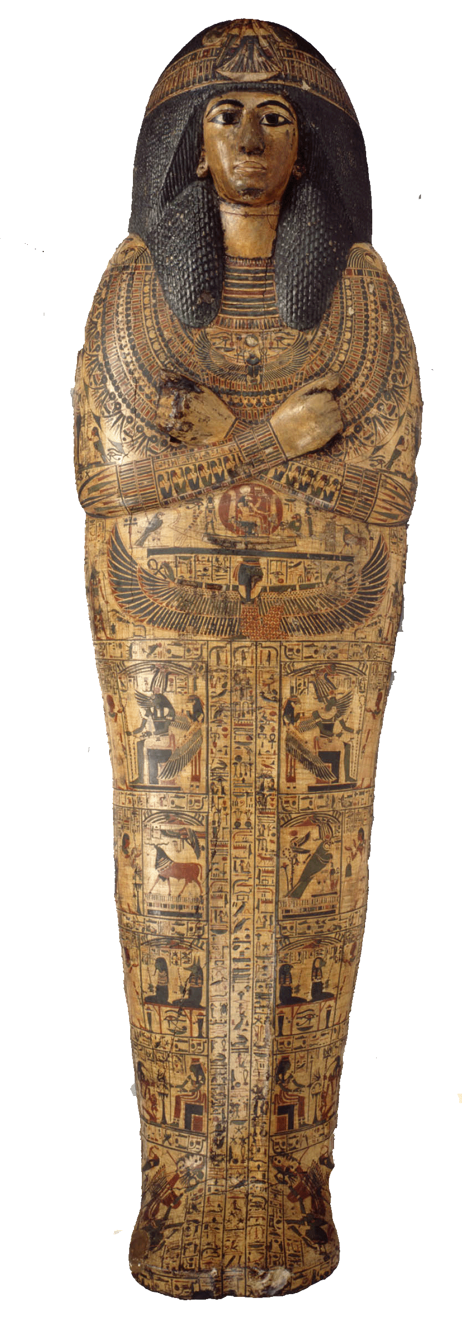
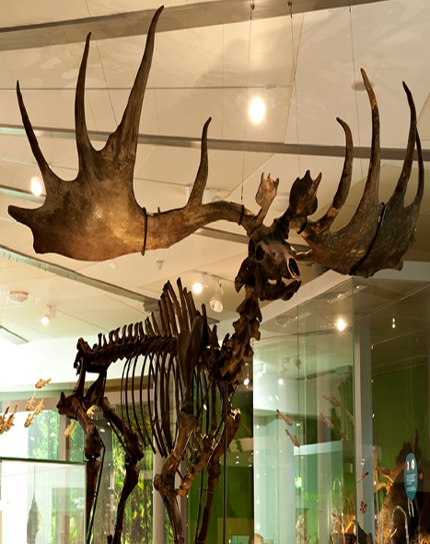
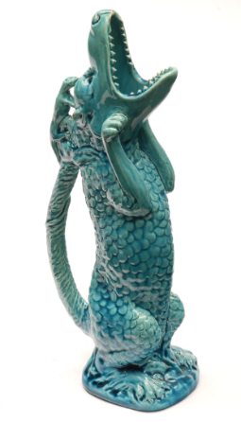
Strike a pose like…
Roman Wolf Mosaic
Myanmar dancers
Egyptian Sarcophagus
Giant Deer
Dragon-shaped Jug

Slide 6
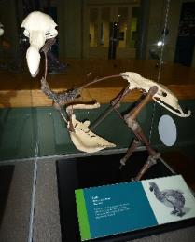
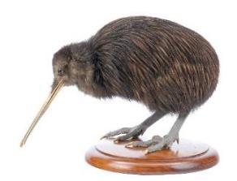
Short Songs about Dodo Bird & Kiwi Bird
They’re subtitled so you can sing along!
You could create your own animal songs.. do do do do do do!
Length of videos:
~2 min

Slide 7
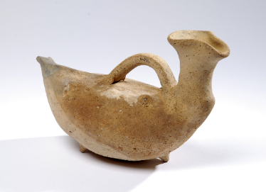
Be a tour guide…
For example:
“Hello. My name is _____ and welcome to my tour. Look at this amazing ancient object. Can you guess what animal it is shaped like?
…Maybe it’s a duck! Does anyone have anything like this at home? …Thanks for listening!”
Continue onto the next slide for some museum objects you could do a tour about…

Slide 8
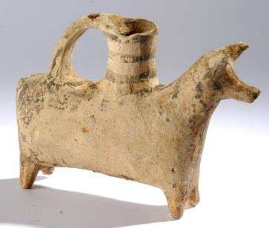
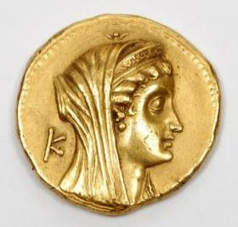
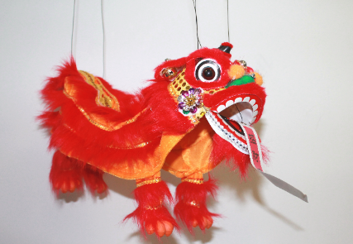
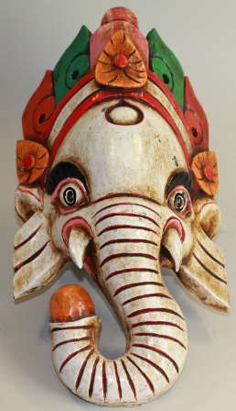
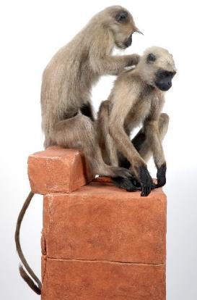
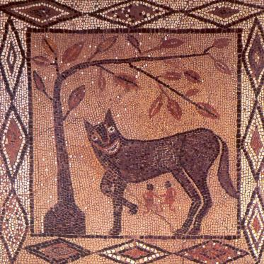
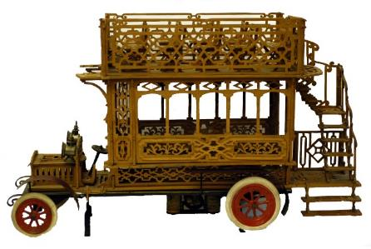
Be a tour guide…
1.
3.
2.
4.
7.
5.
6.
Be confident! Say something interesting about the object… A child once told me a sculpture reminded them of a biscuit! It was a fun way to describe it!
You don’t need to know what the object is, just say what you see!

Slide 9
Watch an Animation about the Armley Hippo & Friends
Length of video:
~5 min
You could:
Think up animal actions when you meet a new character in the story
Write your own story about 125,000 year old hippo bones that were found in Leeds
Draw your own characters for the story

Slide 10
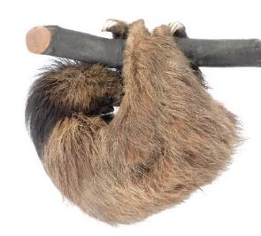
Other Activity Ideas…
Three-toed sloth
Choose 3 objects and write a story
Talk about museums or places you’ve been. Share your favourite memories.
Activities that require some resources:-
Make your own Museum Window
More activities and online exhibitions: museumsandgalleries.leeds.gov.uk/virtual-visit/
Free resources from cultural organisations:
https://www.mylearning.org/
Images © Leeds Museums and Galleries
May be used for Educational Purposes

Slide 11
Get in touch
Suggest other activities you’d like from us
Share your creations – we’d love to see them!
Write us an email to tell us what you’ve been learning about
citymuseum.leeds.gov.uk

