Slide 1
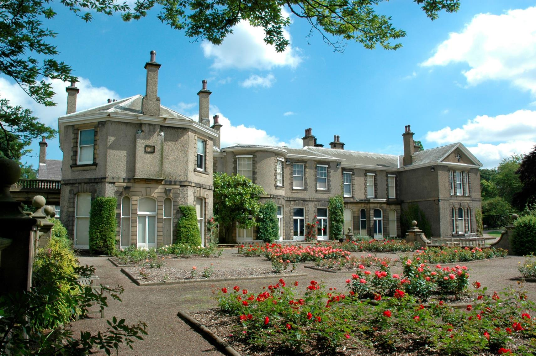
Natural Decoration at Lotherton Hall
Can you find nature in the decorations at Lotherton Hall?

Slide 2
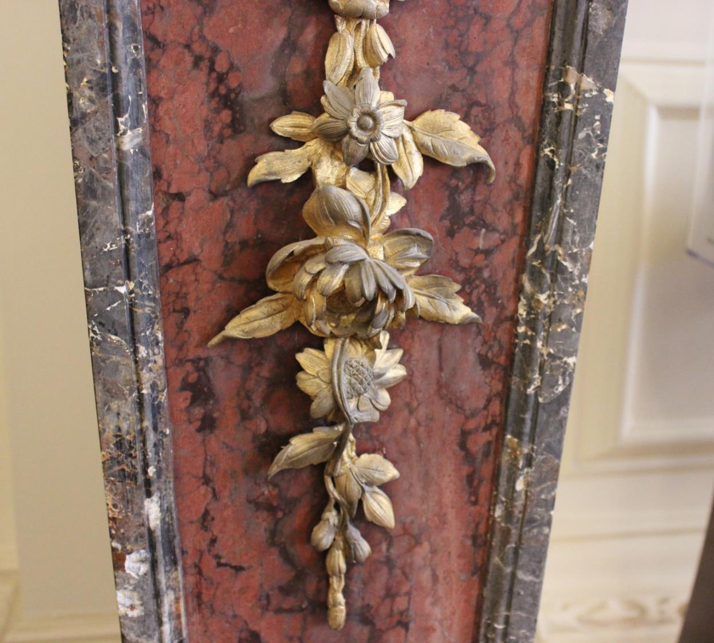
Welcome to the Hall
Can you find nature inside the Hall?

Slide 3
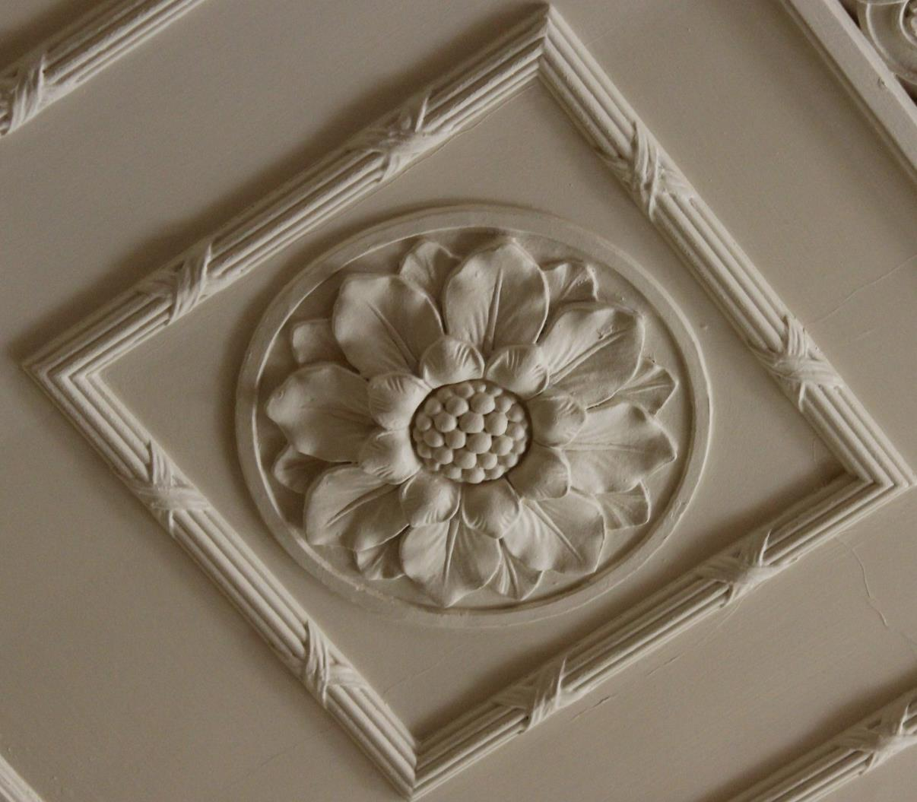
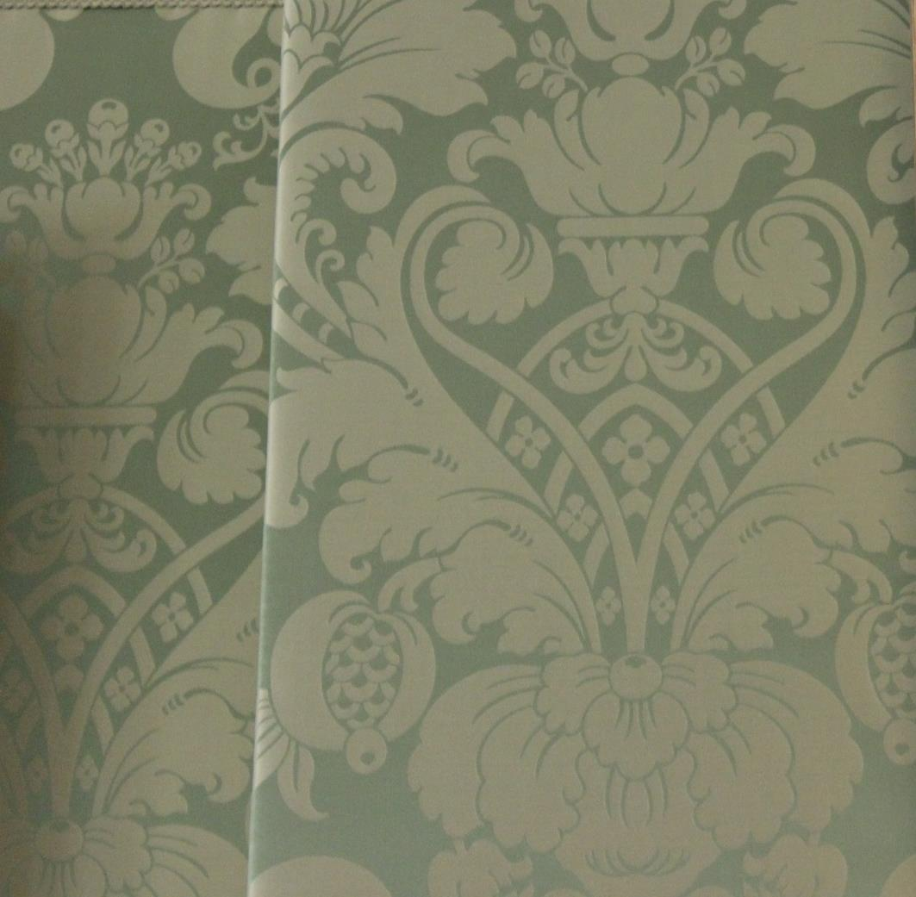
Welcome to the Drawing Room
What nature decorations can you see in this room?

Slide 4
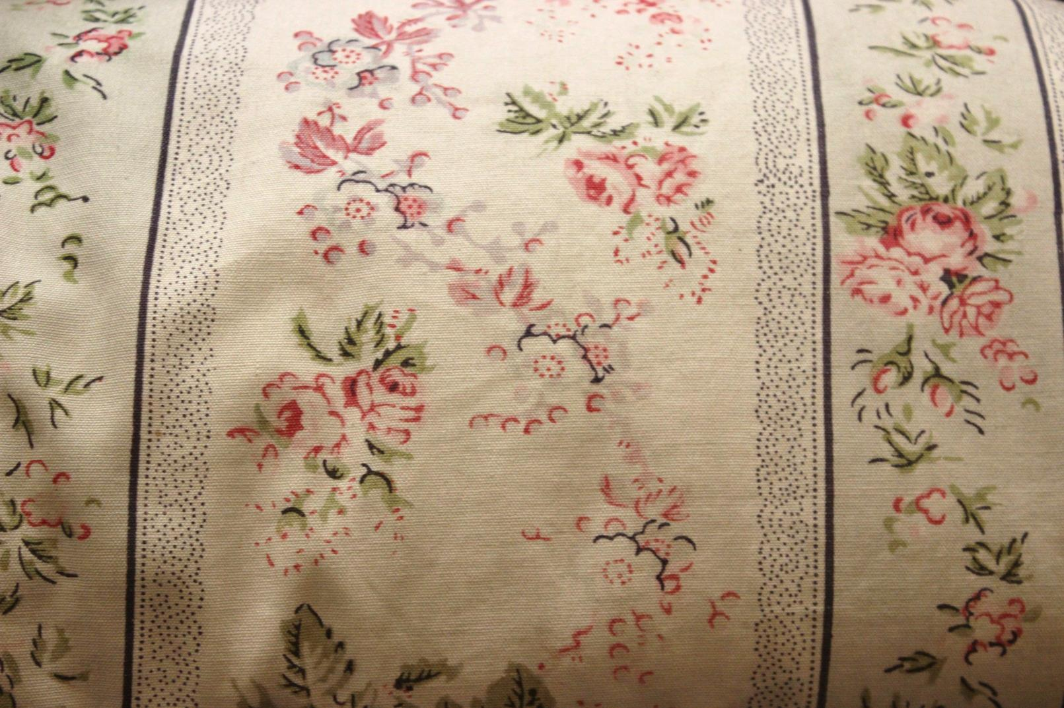
Welcome to the Boudoir
What decorations have been inspired by nature?

Slide 5
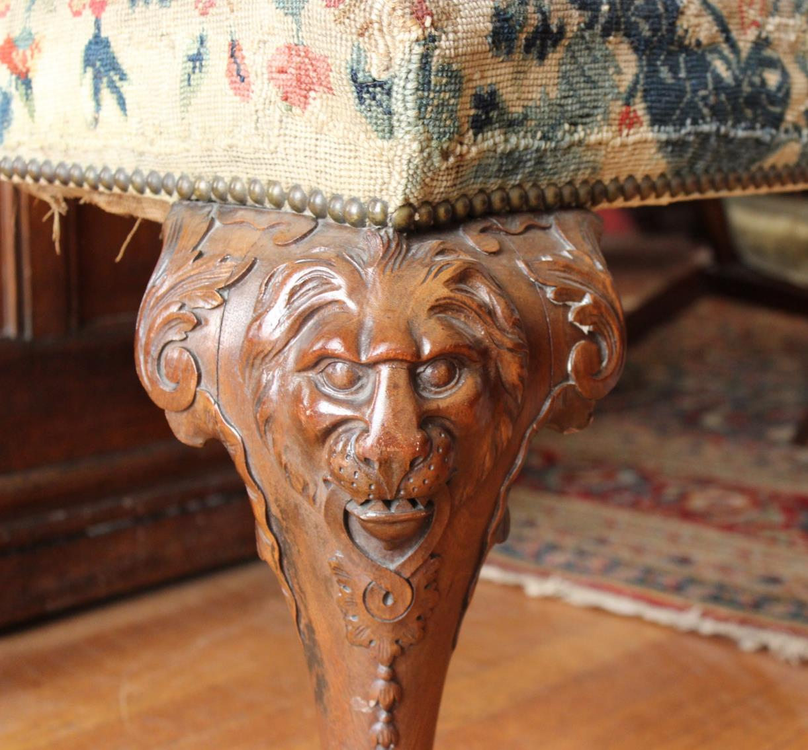
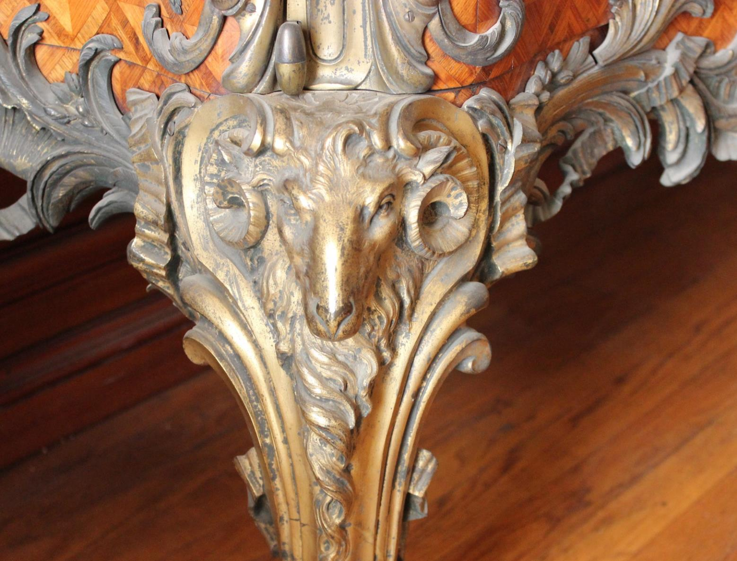
Welcome to the Medal Room
What nature can you see?

Slide 6
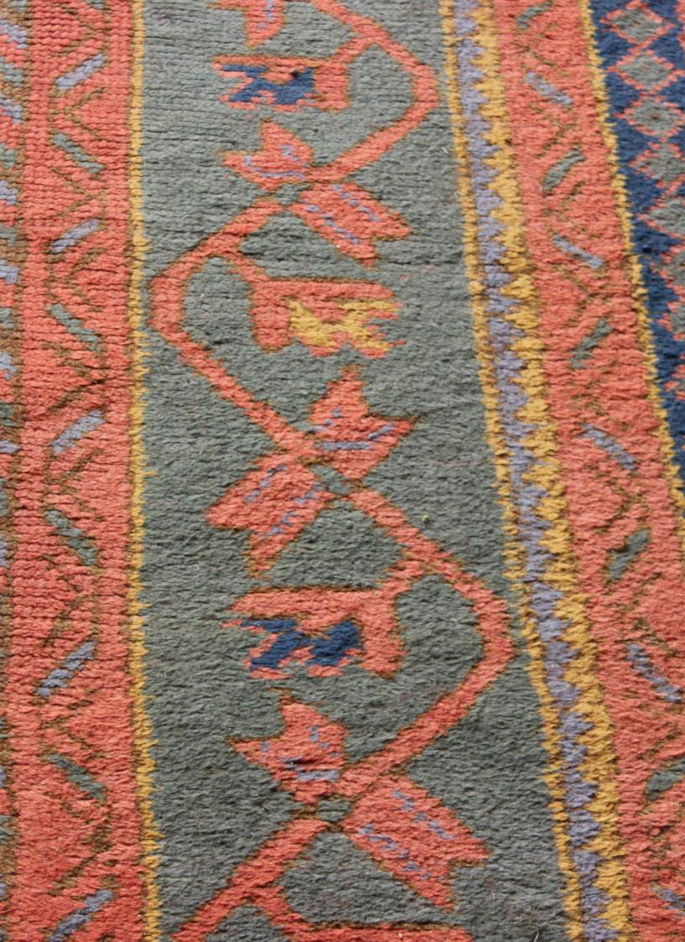
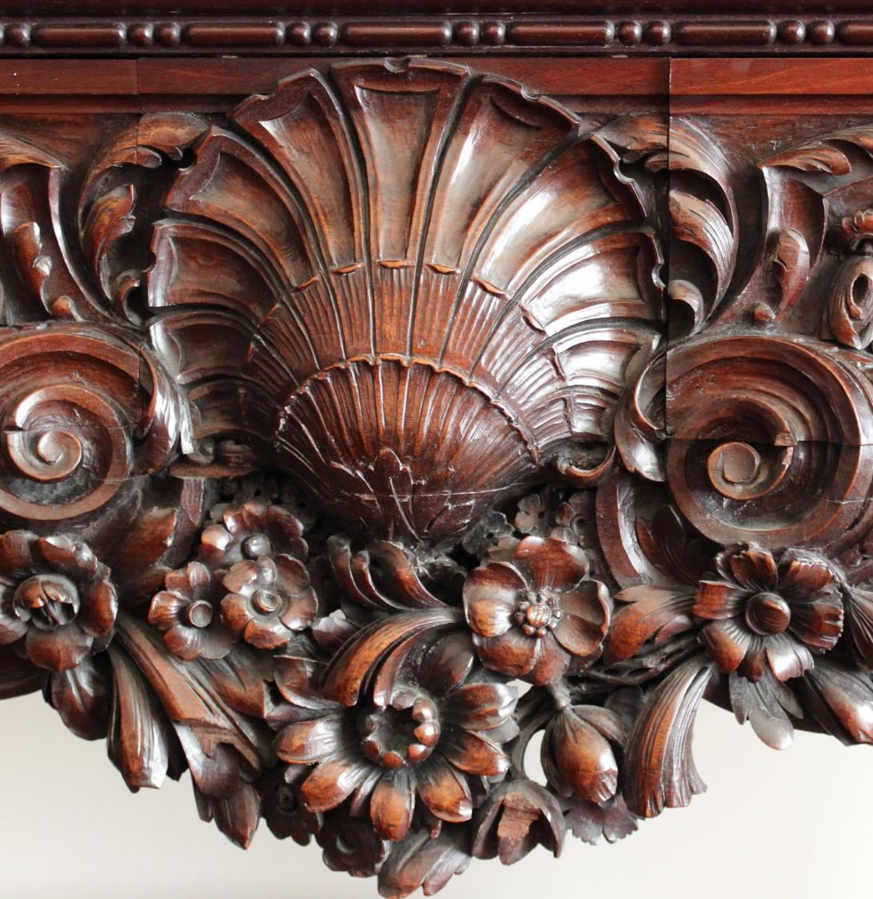
Welcome to the Dining Room
Can you see any natural decorations in here?

Slide 7
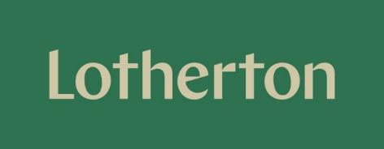
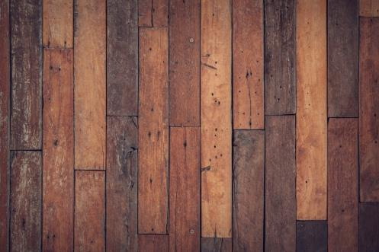
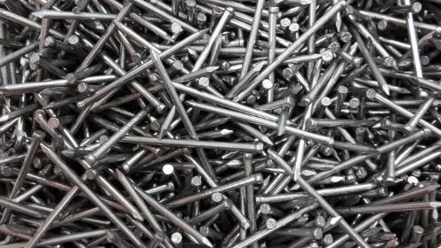
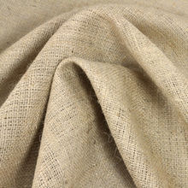
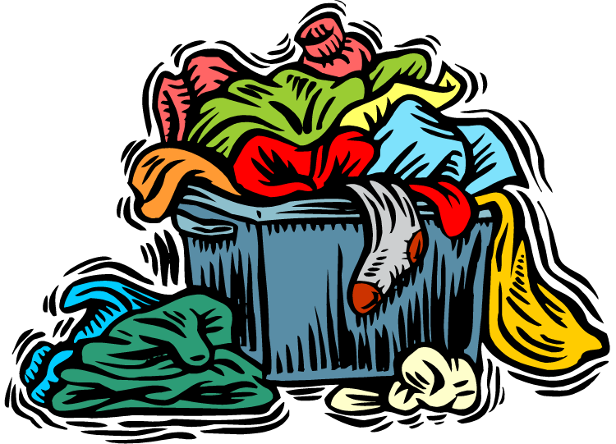
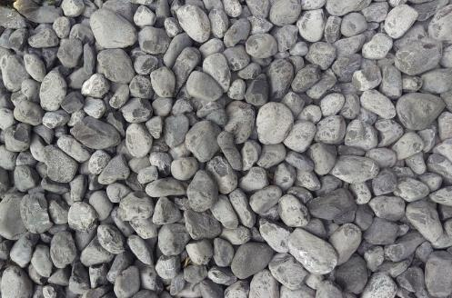
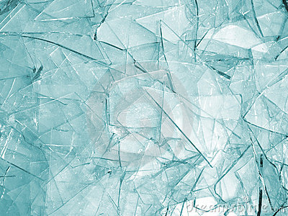
What material are the following objects made from?
WOOD
METAL
FABRIC
STONE
GLASS

Slide 8
GLASS
METAL

Slide 9
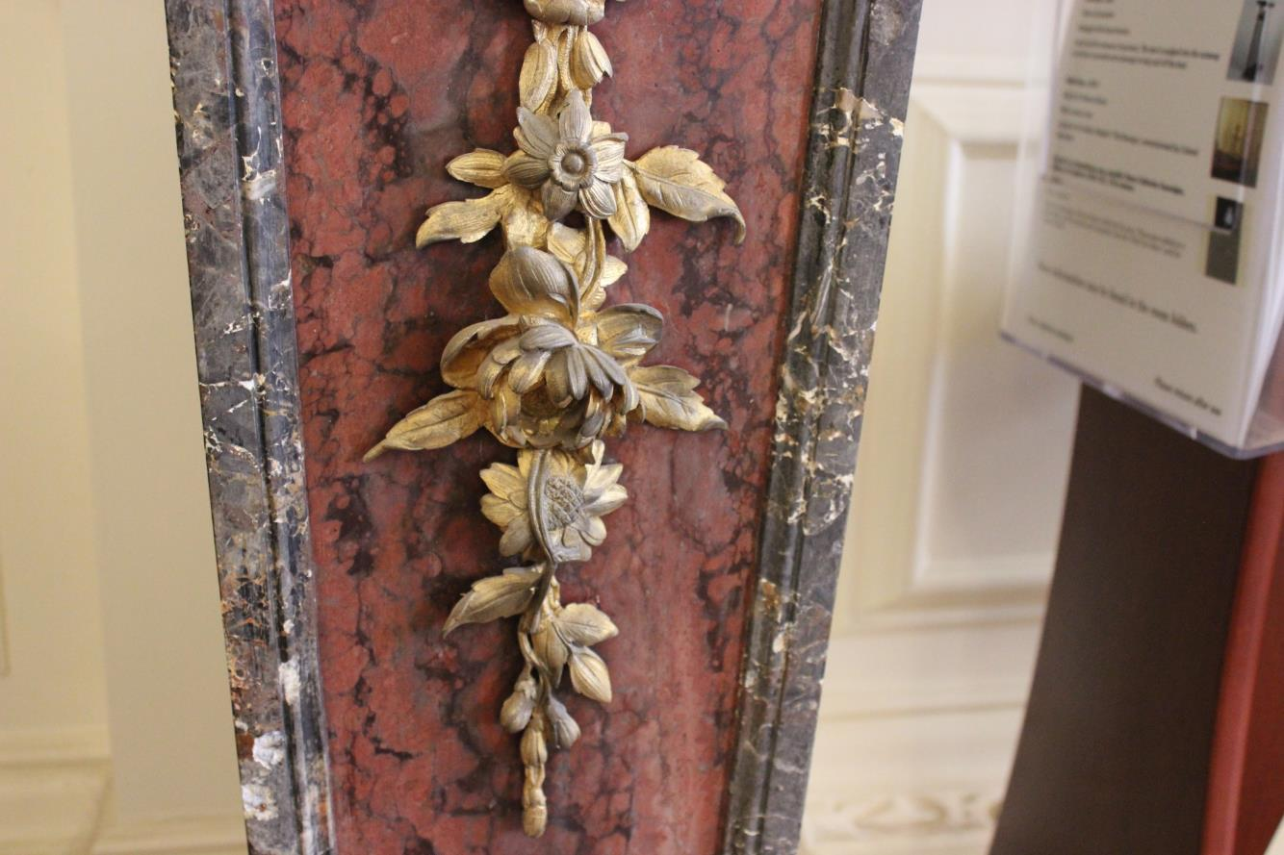
METAL
STONE

Slide 10
FABRIC

Slide 11
FABRIC
WOOD

