Slide 1
Temple Newsam Timeline
Free learning resources from arts, cultural and heritage organisations
^{mylearning.org}

Slide 2
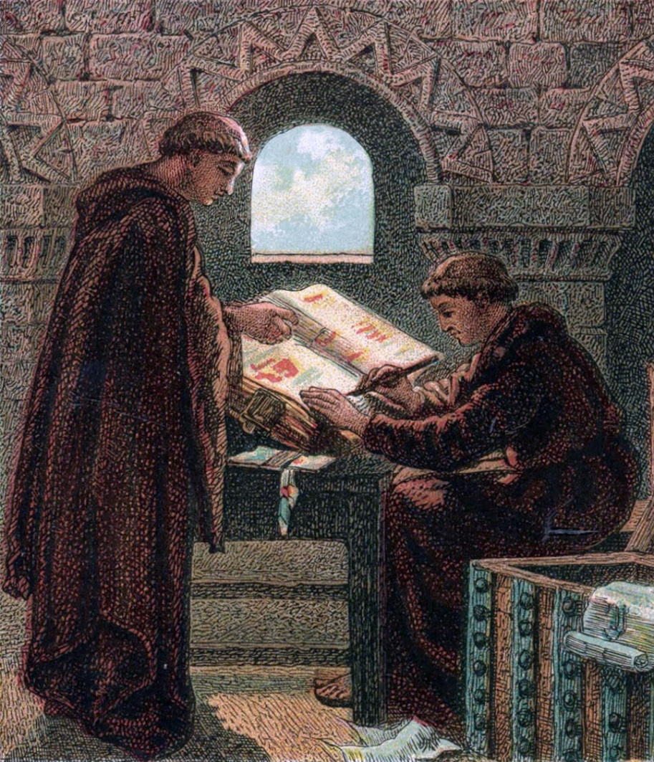
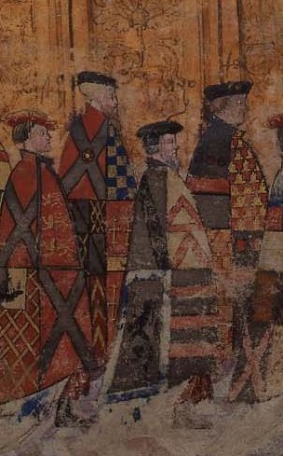
1086
1500 - 1520
The ‘Manor of Newsam’ first appears in the Doomsday book.
‘Manor of Newsam’ means ‘New Houses’
Lord Darcy builds Temple Newsam house.

Slide 3
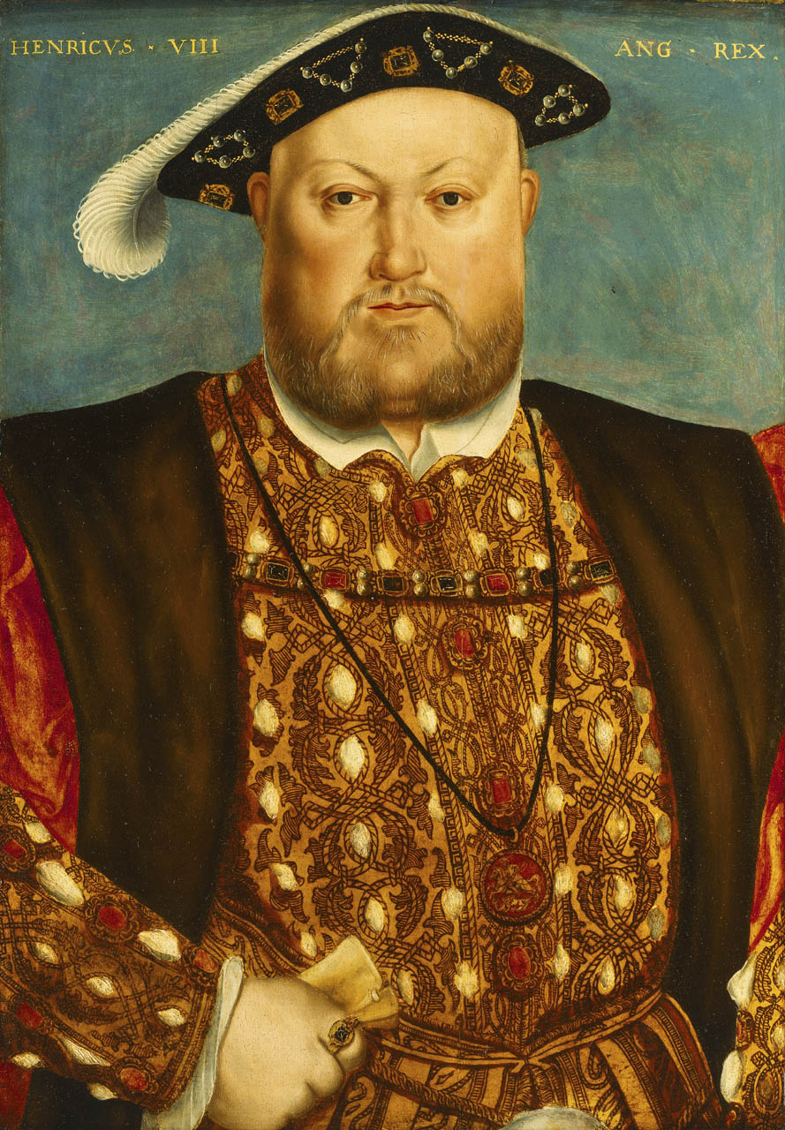
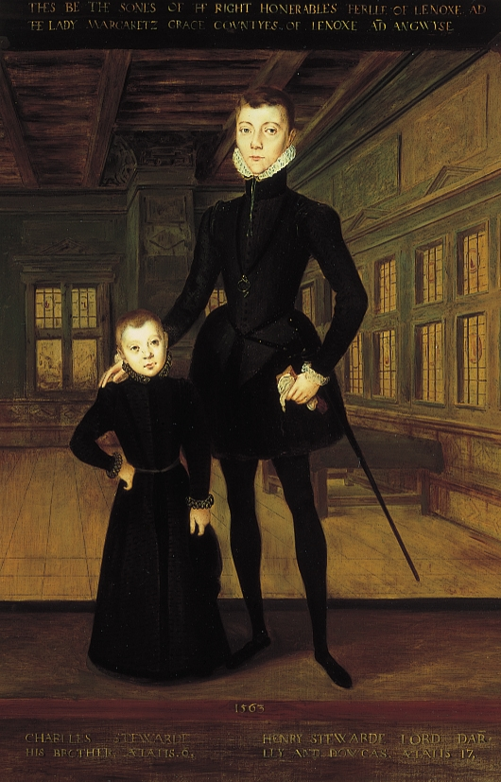
1537
1545
King Henry VIII chops off Lord Darcy’s head for his part in The Pilgrimage of Grace.
Margaret’s son, Henry Lord Darnley, is born at Temple Newsam.

Slide 4
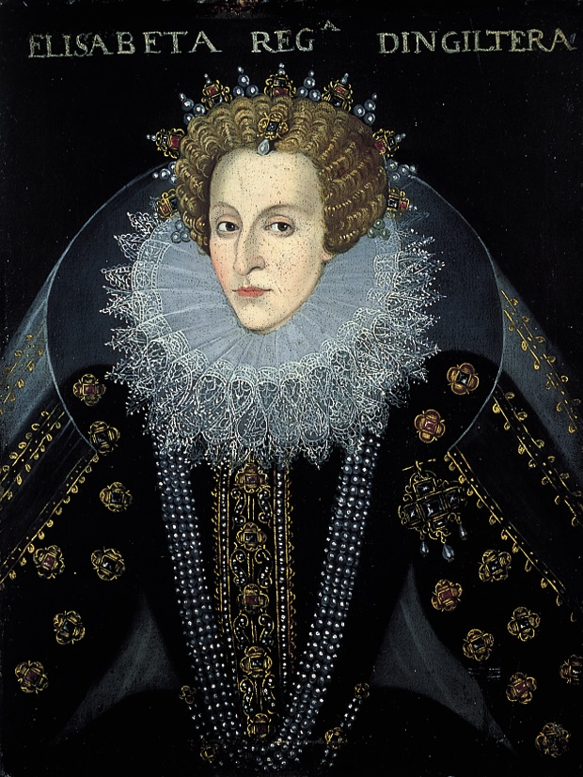
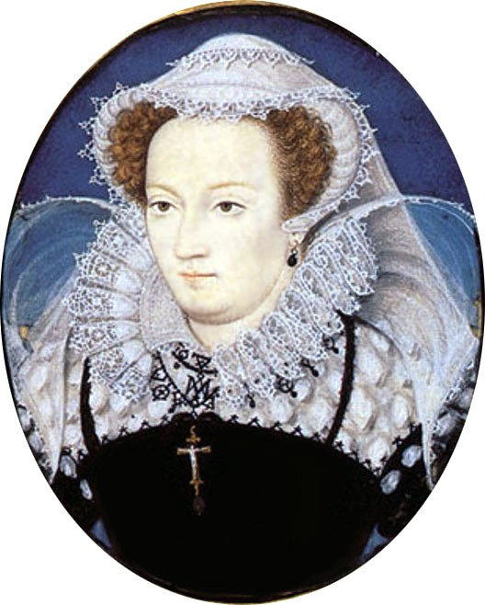
1565
1567
Queen Elizabeth I is on the throne, but Margaret is desperate for her son, Lord Darnley to become King. She arranges for him to meet Mary Queen of Scots and the couple marry in secret.
Henry Lord Darnley is found strangled.
The murder has never been solved, but one suspect is Mary Queen of Scots

Slide 5
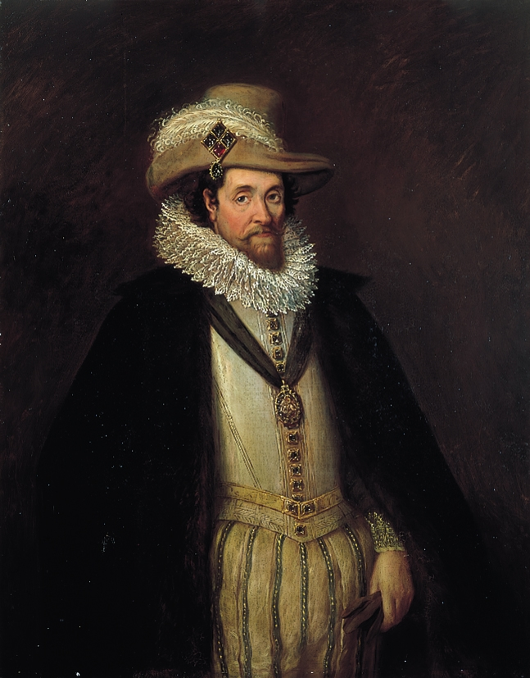
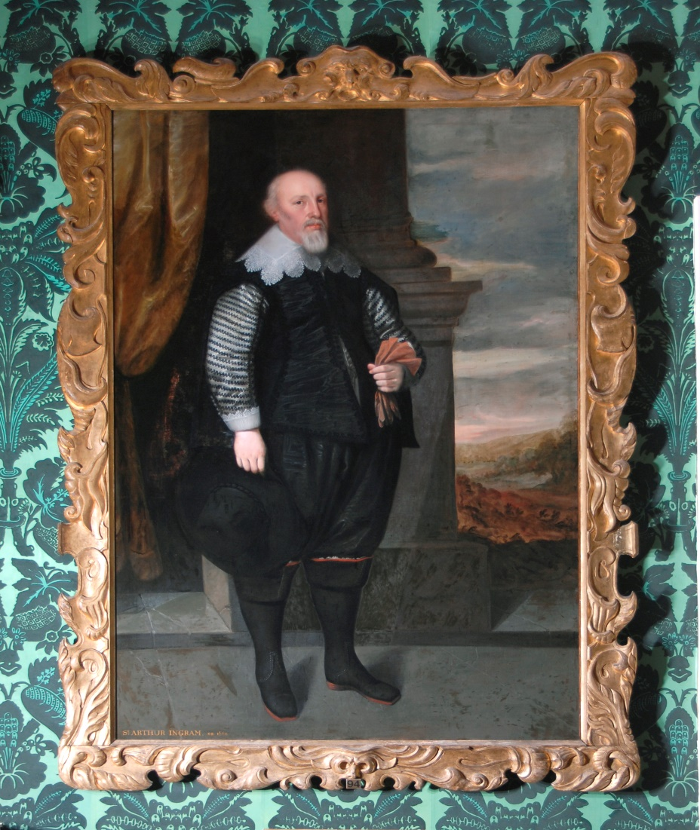
1603
1622
Queen Elizabeth dies without having children, so the son of Lord Darnley and Mary Queen of Scots, James 1 inherits Temple Newsam.
The Duke of Lennox is in lots of debt, so he sells Temple Newsam to property developer Arthur Ingram for £12,000.

Slide 6
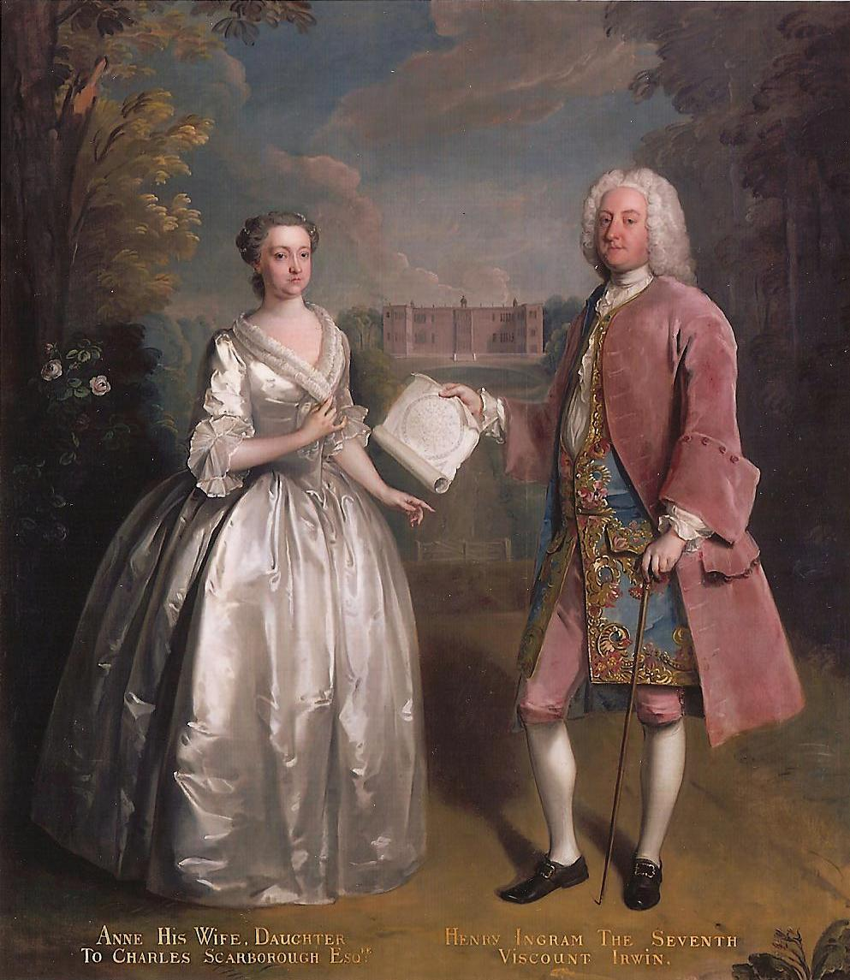
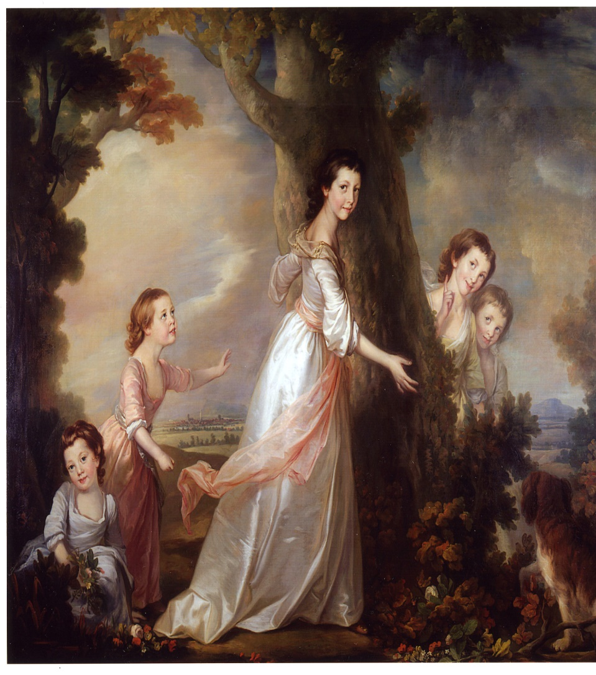
1642 - 1758
1806
Temple Newsam passes down the Ingram family line.Henry Ingram goes on a Grand Tour and collects paintings and other artworks. In1736 he creates the Picture Gallery you can still see at Temple Newsam today.
Charles Ingram inherits Temple Newsam. He marries a wealthy heiress, Frances Shepheard, and using her money, Temple Newsam is transformed.

Slide 7
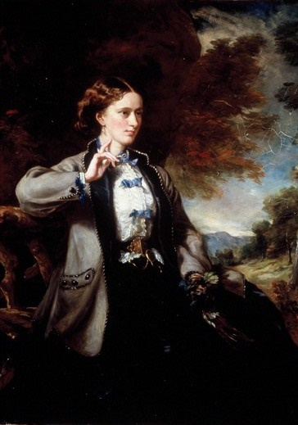
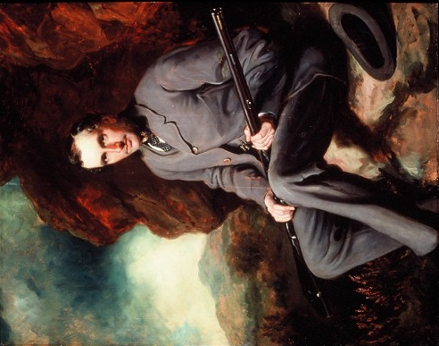
1871
1904
Lady Hertford dies, and the third sister’s son, Hugo Charles Meynell Ingram inherits Temple Newsam.
Hugo dies in 1871, leaving Emily as the sole proprietor
Emily Wood is now almost as rich as Queen Victoria herself!
She spends a lot of money developing Temple Newsam.

Slide 8
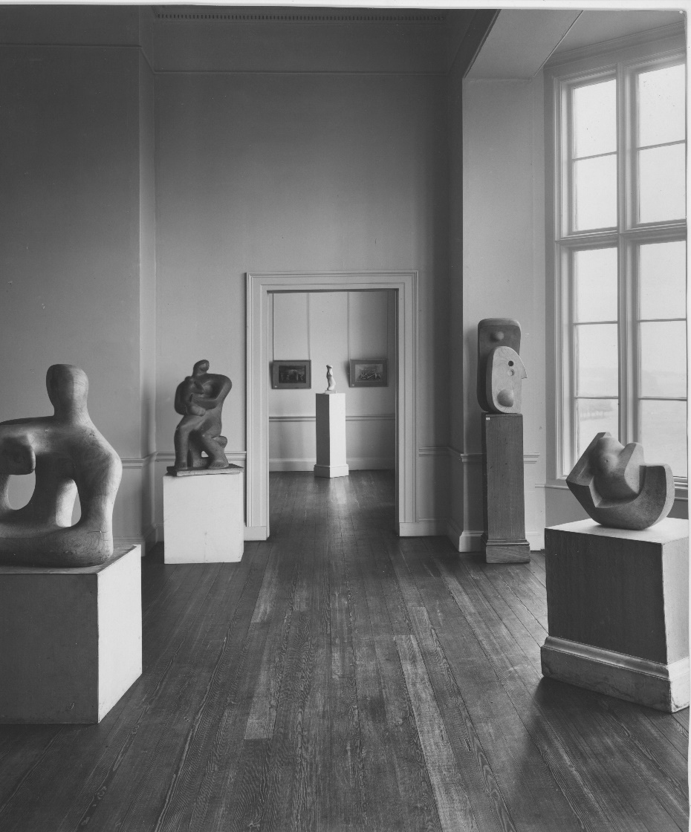
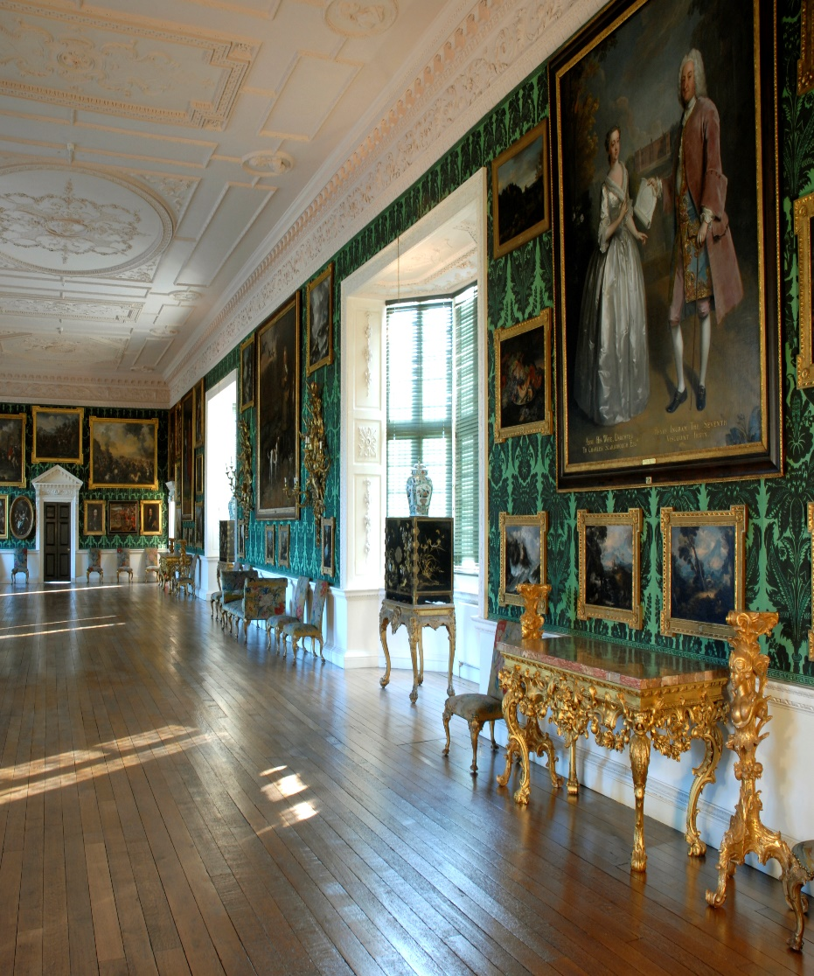
1940s
1996
Temple Newsam house is an art gallery, showing works by young artists such as Henry Moore and Barbara Hepworth.
Leeds City Council restores Temple Newsam for its 250th Anniversary.

Slide 12
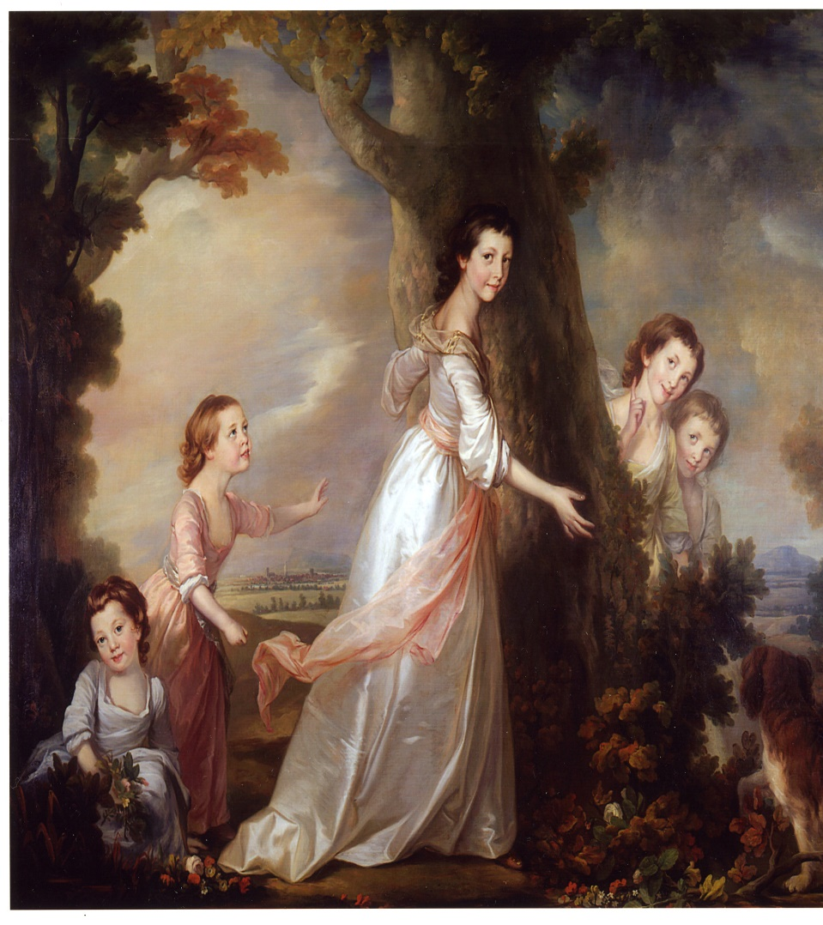

Slide 13
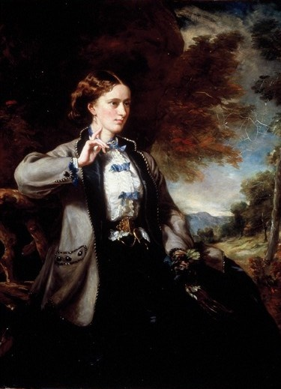

Slide 14

